Slide 1
City of Tacoma 2021 Stormwater Management Manual
2021 Manual Updates, Stormwater Site Plans, Minimum Requirements Determinations
June 2021
Notes:
Merita

Slide 2
Housekeeping
This Presentation is Being Recorded.
You have been muted – feel free to sing along…
Zoom Features For Today
Chat Feature
Technology Questions/Issues– Chat to Panelists
General Chatter, Encouragement, Etc. – “Cute Dog Mieke.” “Love that feature of tMap.” “City of Tacoma Employees are the best!” – Chat to Everyone
Questions about the Presentation
Use the Q&A Feature
Surveys!
These should pop up on your screen – please participate! There might be prizes…
Patience is Appreciated
Technical issues, short delays, barking dogs, crying babies, chirping birds, helicopters, etc., etc., etc. are just one of the many fun part of the presentation!
Notes:
Merita

Slide 3
Agenda
2021 SWMM Update & everything stormwater
Introductions
Accela Permitting Overview
NPDES Regulations
SWMM 2021 Update
Break
Minimum Requirements Overview
Stormwater Site Plan Template ^{new!}
Break
Minimum Requirement Thresholds
Lunch
MRs #1-5
Break
MRs #6-9
Break
Infrastructure Protections
Final Thoughts
Notes:
Merita

Slide 4
Welcome – Meet the Presentation Team
Mieke Hoppin - Environmental Services (ES)
Stormwater Management Manual Update Lead
Today: Co Presenter
Joy Rodriguez - Planning and Development Services (PDS)
Principal Engineer – Site and Building Group
Today: Co-Presenter
Brenda Reifsnyder – PDS
Permit Specialist Lead
Today: Special Guest Speaker
Chris Johnson – PDS
Senior Principal Engineer – Site Development Group
Today: Special Guest Speaker
Merita Trohimovich – ES
Principal Engineer – NPDES Group
Today: Presentation Facilitator
Notes:
Merita – Introduce and Full Team Wave at Camera

Slide 5
Survey #1 Who is Joining Us Today?
Notes:
Mieke and Merita – Poll #1

Slide 6
Permitting Overview
And now over to our special guest speaker…
Notes:
Chris and Brenda.

Slide 7
Today’s Presentation is…
Learning!!!
Quick Overview of City of Tacoma Permits – It was Great!
Overview of the City of Tacoma Stormwater Management Manual
How to Successfully (fingers crossed) Complete a Stormwater Site Plan
An ability to use your imagination!
Ask Questions at any time! Remember to use Q&A Feature.
Scheduled Breaks Throughout
30 Minute Lunch Break
Staff will be available to answer specific questions.
Jokes
Dancing
Notes:
Mieke

Slide 8
Today’s Presentation is Also…
A lot of information
A lot of jargon
An attempt to distill 1000 pages to something slightly more manageable.
Going to be available online as a resource.
Only one additional resource
The SWMM itself
Tip Sheets
City staff!

Slide 9
Today’s Presentation is not…
How to Determine Offsite Improvements
Electronic File Standards
Code Citations
Project Specific
Going to Put You to Sleep (fingers crossed).
***************************************************
Additional information on some of the above topics can be found in Tip Sheets available at tacomapermits.org
Notes:
Mieke

Slide 10
Why?!?
Development increases stormwater because creates surfaces for rain/snow to runoff.
Unmitigated stormwater has negative effects on receiving waterbodies and infrastructure.
Negative effects of stormwater:
Stormwater Picks Up Pollutants
Increased Flowrates Cause Erosion → More Pollutants
Pollutants → Fish Kill
https://www.youtube.com/watch?v=omUuWxP8YFU
Flooding
https://www.youtube.com/watch?v=L1Y3740YzOc
Notes:
Mieke

Slide 11
Why? Federal/State Regulations!
The Clean Water Act (1972) created the NPDES (National Pollutant Discharge Elimination System) Permit Program which required regulating point discharges.
1987 the Clean Water Act was amended to include stormwater discharges from Municipal Separate Stormwater Systems (MS4s).
1990 – Phase I regulations went into effect to allow discharges from MS4s.
Jurisdictions serving more than 100,000 people.
1995 – Ecology issued first Phase I Municipal Stormwater Permit.
1999 – Phase II regulations went into effect.
Smaller MS4s
2007 – Ecology issued first Phase II Permit
Notes:
Mieke

Slide 12
Why? Regulations…
The Clean Water Act prohibits anybody from discharging pollutants through a point source without an NPDES permit.
The City of Tacoma has a Phase I Municipal Stormwater Permit that allows the City to discharge stormwater to receiving waterbodies.
The Permit is issued by the Washington State Department of Ecology
The Permit requires a “program to prevent and control the impacts of runoff from new development, redevelopment, and construction activities.
The City has elected to provide a Stormwater Management Manual equivalent to the Washington State Department of Ecology’s July 2019 Stormwater Management Manual for Western Washington.
The SWMM helps ensure infrastructure that is safe, effective, efficient, economical, and sustainable.
The Stormwater Management Manual is codified in Tacoma Municipal Code 12.08D – Stormwater Management
Notes:
Mieke

Slide 13
How? Regulations!
Permittees must document the technical basis for design criteria used to select and design BMPs. This includes:
how BMPs were selected,
pollutant removal performance expected from BMP,
the scientific basis, technical studies, and modeling specific to the design criteria to support performance claims
Assessment of how the selected BMP will comply with State water quality standards and meet AKART (all known, available and reasonable methods of prevention control and treatment).
So, how does the City of Tacoma go about doing that…
Notes:
Mieke

Slide 14
How? Regulations!
The Presumptive Approach – Used by the City of Tacoma
Ecology’s SWMMWW is presumed to provide AKART when the proper BMPs are sized per the SWMMWW because the BMPs have been evaluated based on the design criteria.
Equivalent stormwater management manuals are presumed to provide AKART.
The Demonstrative Approach
Project proponents who choose not to follow the design criteria for BMPs in the SWMM are not following the presumptive approach and must demonstrate that their project will not adversely impact water quality by collecting and providing supporting data to show that the alternative approach is protective of water quality and satisfies state and federal laws
Will likely require sampling of BMP or approach.
Notes:
Mieke

Slide 15
How? City of Tacoma SWMM
Relies on complying with Minimum Requirements and Additional Protective Measures to mitigate the negative effects of stormwater and ensure receiving waterbodies and the conveyance system are protected.
Notes:
Mieke

Slide 16
Why? The Future Depends on You!
Many people interact with a stormwater site plan and plan set once it has been approved:
Property Owners
Can a property owner find the facilities and assets they need to maintain years from now?
Contractors
Can a contractor understand what they are supposed to build?
Inspectors
Is it easy for an inspector to know all the components to inspect?
City Asset Management Staff
Mapping, Database Management
Business Inspection Staff
1, 5, 10, 20, 50 years from now will a new employee be able to figure out what is on the property for required inspection?
Facility Inspection Staff
1, 5, 10, 20, 50 years from now will an employee be able to figure out what facilities are on a property and how they function.
Operation and Maintenance Staff
Can crews figure out what the facility is and how to inspect and maintain the facility (is it even owned by the jurisdiction?)
Complaints
10 years from now when there is a drainage complaint can City staff easily help a property owner navigate the assets on their site?
Notes:
Mieke

Slide 17
Where are we?
October 1995 Manual
Developed for 1995 NPDES Permit (Equivalent to Ecology’s 1992 Manual)
January 2003 Manual
Developed for extension of 1995 NPDES Permit (Equivalent to Ecology’s 2001 Manual)
September 2008 Manual
Developed for 2007-2012 NPDES Permit (Equivalent to Ecology’s 2005)
February 1, 2012 Manual
Developed in response to local community concerns and questions (developers, engineers, City staff).
January 2016 Manual
Developed for 2013-2018 NPDES Permit
July 2016 Manual – Current Version
Errata to January 2016 Version
July 2021 Manual
Public Comment Period - July 2020
Deemed Equivalent to Ecology 2019 SWMMWW – Feb. 2021
SEPA Process – March 2021
Adopted by Council – May 2021
Trainings!!
Must start using July 1, 2021
Notes:
Mieke

Slide 18
Questions? Please Use Q&A…and a joke!
Q. How do you fix a broken tomato?
A. With tomato paste!
Notes:
Mieke

Slide 19
2021 SWMM – Update Types
Permit Compliance
Appendix 10
Changes to Meet Ecology Intent
Update for Clarity
New Layout!
Mistakes
Seems impossible but it’s true.
No Longer Applicable
Notes:
Mieke
These are changes you may see with other jurisdictions as well – Phase Is are all required to update their Permit.

Slide 20
Permit Compliance Updates
Continuous Simulation Modeling
Requires the use of modeling software that:
Can directly model BMPs that may be used for Low Impact Development
Have 15-Minute Timesteps
Incorporates the van Genuchten algorithm to model bioretention.
COT SWMM allows the use of Ecology-approved models – which currently include – check ECY SWMM Page For Updates:
WWHM2012 – Version 4.2.16 or later.
MGSFlood (version 4.49) – Limited Approval – Not Allowed for Bioretention Modeling
Notes:
Mieke

Slide 21
Permit Compliance Updates
Replaced Hard Surfaces Redevelopment Thresholds
Updates to require the project proponent to compare the value of the proposed improvements to the value of the Project Site (limits of disturbance) improvements rather than Site (entire parcel) improvements.
Other types of redevelopment projects shall comply with all the MRs for the new and replaced hard surfaces and the converted vegetation areas, if for commercial and industrial projects, the valuation of the proposed improvements, including interior improvements, exceeds 50% of the assessed value of the existing Site improvements.
Reason: To ensure that projects that create impacts are mitigating for those impacts appropriately.
Notes:
Mieke
This applies to when replaced hard surfaces for redevelopment projects must comply with Minimum Requirements beyond Minimum Requirement #1-5 – so things like water quality and flow control.
The current SWMM requires replaced surface be brought up to certain standards when the valuation of the improvements exceeds 50% of the assessed value of the site conditions (so this could include valuation of many buildings/structure.
The new language requires (for commercial and industrial projects only) the valuation to be compared to just the project site or land disturbance areas) conditions – so that valuation will be lower and it will be more likely that the 50% threshold is met.
This will have implications for strip mall type and industrial type locations where there are multiple buildings on a parcel.
The next slide shows this in a little diagram.

Slide 22
Replaced Hard Surface Redevelopment
2016 SWMM
2021 SWMM
$
$$
$
Existing Site Conditions
$$$
$
Project
Site
$
Compare $ to $$$$$$$
Notes:
Mieke

Slide 23
Permit Compliance Updates
Minimum Requirement #2
Updates to language to meet changes made to the Construction Stormwater General Permit.
Notes:
Mieke

Slide 24
Permit Compliance Updates
Minimum Requirement #5
Updates to ensure BMP L613: Post Construction Soil Quality and Depth is required when utilizing the LID Performance Standard
Updated whole section to meet Ecology’s intent creating 3 Lists for List Approach – similar to Ecology.
Discharges to Flow Control Exempt Waterbodies (includes salt waterbodies) now have a required order of preference for choosing BMPs (previously you could pick any from list as first choice). Example Below for Roofs:
Downspout Full Infiltration
Downspout Dispersion
Perforated Stub-Outs
Notes:
Mieke
Minimum Requirement #5 allows the use of the List Approach or the LID Performance Standard Approach. This change makes it clear that BMP L613 is required when using the LID Performance Standard Approach.
We also updated MR#5 to meet Ecology’s intent and created 3 lists for the list approach – List #1 for projects that just trigger MR#1-5, List 2 for projects that trigger MR#1-9 and List #3 for Flow Control Exempt Waterbodies.
The existing SWMM does not have a required order of preference when discharging to flow control exempt waterbodies, the new SWMM will to be in line with Ecology’s intent.

Slide 25
Permit Compliance Updates
Minimum Requirement #7
Updates to ensure TDAs discharging to marine waterbodies meet all requirements of flow control exempt waterbodies before it is determined that flow control is not required.
Requirements include: making sure stormwater is not directed away from certain streams and wetlands or if it is it is directed in a way that maintains wetland hydrology; there is a manmade conveyance system that extends to the ordinary high water line, the conveyance system has sufficient hydraulic capacity to convey discharges, erodible elements of the system are stabilized
Notes:
Mieke
Marine waterbodies were added to the list of flow control exempt waterbodies. The current list includes the Puyallup River and First Creek.
Flow control exempt waterbodies do not have to provide flow control to meet MR#7 (waterbody protection) if various criteria are met including that the project:
Does not divert streams
Does not affect wetlands
Must have conveyance system comprised entirely of manmade conveyance
Conveyance system must have sufficient hydraulic capacity
Manmade conveyance must be stabilized.

Slide 26
Permit Compliance Updates
Concrete Washout BMP
Update to clarify that auxiliary concrete truck components and small concrete handling equipment may be washed into formed areas awaiting pour while concrete truck drums must be washed offsite or into a concrete washout area.
Notes:
Mieke

Slide 27
Permit Compliance Updates
Source Control BMPs Added
BMP S113: Dock Washing
BMP S116: Storage of Dry Pesticides
BMP S155: Nurseries and Greenhouses
BMP S146: Irrigation
BMP S124: In-Water and Over-Water Fueling
BMP S153: Color Events
BMP S149: Pet Waste
BMP S162: Well, Utility, Directional and Geotechnical Drilling
BMP S129: Roof Vents
BMP S148: Goose Waste
Notes:
Mieke

Slide 28
Permit Compliance Updates
Wetlands Guidance
Changes to require monitoring and modeling of high value wetlands.
New requirements will require knowing wetland type for determining modeling and mitigation requirements (required wetland delineation report). Level of Wetland Protection is based on:
Wetland Category into which TDA discharges.
Whether or not the TDA triggered MR#7 – Flow Control.
Whether or not the wetland is a depressional or impounded wetland.
Whether or not the project proponent has legal access to the wetland.
The wetland habitat score.
Whether or not the wetland provides habitat for rare, endangered, threatened, and/or sensitive species, and
Whether or not there is a presence of a breeding population of native amphibians.
Notes:
Mieke
Higher value wetlands will require a year of monitoring.

Slide 29
Ecology Intent Updates
Changes throughout entire Manual to mirror Ecology language or revise language to meet Ecology’s intent. These are mainly items Ecology updated for clarity. Below is one example:
Pavement Maintenance Exemption:
Previous: Resurfacing by upgrading from dirt to gravel, asphalt, or concrete.
Updated: Resurfacing by upgrading from dirt to gravel, bituminous surface treatment, asphalt, or concrete.
Notes:
Mieke

Slide 30
Ecology Intent Updates
Oil Control Threshold Change
Areas of commercial or industrial sites subject to an expected average daily traffic (ADT) count equal to or greater than 100 vehicles per 1,000 square feet of gross building area, or 300 total trip ends per day.
300 total trips ends per day helps ensure larger buildings are included in the oil control threshold
Notes:
Mieke
The current SWMM requires oil control for projects that trigger Minimum Requirement #6 and
have average daily traffic counts equal to or greater than 100 vehicles per 1,000 square feet of gross building area.
Store larger amounts of petroleum
Park Large Vehicles
Or are high ADT intersections.
The new requirements adds total trips ends.
Because of the gross building area – larger buildings would often not require oil control but smaller buildings would though pollutant characteristics are similar or worse for larger buildings. Ramifications is that “big box” stores will likely require oil control because of trip ends.
Trip end – daily vehicles in/out of a property.

Slide 31
Clarity and Grammar
Changes made throughout manual to clarify language.
Move sections/chapters/volumes for ease of use.
Changes made to update website links, fix typos, shorten run-on sentences, etc.
Based on feedback from over the years from internal/external customers – thanks!!
Notes:
Mieke
Includes making sure the information you need is all in a section of referenced appropriately.
Language changes for consistency throughout.
Language changes for industry standard and education and outreach purposes.

Slide 32
New Layout
Preface
This includes a short description of the watersheds, applicability, relationship to Permit.
Volume 1 – Minimum Requirement and Additional Protective Measures
How to determine MRs, and what the MRs are.
Volume 2 – Documentation
Description of Documentation Needed to Comply with SWMM – SSP, SWPPP, Drawings
Similar to Appendix in 2016 SWMM – Volume 1
Volume 3 – Construction Stormwater Pollution Prevention BMPs
Design criteria for BMPs for temporary erosion and sediment control during construction.
Similar to 2016 SWMM - Volume 2.
Volume 4 – Best Management Practices Library
Design criteria for all permanent stormwater BMPs.
Similar to 2016 SWMM – Volumes 3, 5, 6
Volume 5 – Stormwater Conveyance Design
Information on how to design conveyance system, approved materials, etc.
Similar to 2016 SWMM - Volume 3.
Volume 6 – Source Control
Information about long-term BMPs required on sites for source control.
Similar to 2016 – SWMM – Volume 4
Notes:
Mieke
The idea behind the new layout is to make the manual more user friendly. Volumes are in general meant to mimic Minimum Requirements – so for example Volume 3 corresponds to MR#3 and contains information within that Volume to help understand what is needed to mitigate appropriately for that MR.

Slide 33
City Updates
Only 9 Minimum Requirements
One Additional Protective Measure – Infrastructure Protection (Was MR#10)
Updated so City of Tacoma makes determination of mitigation needs to protect our system.
New BMPs
Portable Sediment Tank
Discharge to Wastewater System
Rooftop Dog Run
Updates throughout that clarify language.
Gender neutrality updates to language throughout.
Changes to use similar terms throughout.
Notes:
Mieke
Infrastructure Protection was altered to remove the qualitative downstream analysis. The City learned that issues found in the field are pretty common throughout the City – ponding in low spots, leaf fall, etc.
The quantitative analysis thresholds remain the same – projects will still be required to complete a quantitative analysis but the mitigation needs will be project specific based upon the City knowledge of the downstream system.
Onsite detention, upsizing the downstream system, possibly payment into a program, or maybe no mitigation are all possible. The goal is to holisitically work to upgrade and improve the stormwater system in a way that makes sense instead of small piece-meal fixes that might not make the most sense in the overall scheme of things.

Slide 34
Tacoma Municipal Code Update
TMC 12.08 will be divided into 4 sections
12.08A – General Administration
12.08B – Use of Sanitary Sewer
12.08C – Industrial Wastewater Pretreatment Program
12.08D – Stormwater Management
New code will go into effect July 1, 2021
A few minor revisions to 12.08D for compliance with the 2019 NPDES SW Permit
No substantive changes / Updates for clarity
Officially changes name from “Surface Water” to “Stormwater”
Use 12.08A and 12.08D to understand stormwater code
Notes:
Mieke

Slide 35
Questions? Please Use Q&A…and a joke!
Q. Why did the tomato go out with a prune?
A. Because it couldn’t find a date!
Notes:
Mieke/Merita

Slide 36
Break!!!
Notes:
Play Music

Slide 37
SWMM – Minimum Requirements (MRs)
MR #1 – Preparation of Stormwater Site Plans
MR #2 – Construction Stormwater Pollution Prevention
MR #3 – Source Control
MR #4 – Preserving Drainage Patterns and Outfalls
MR #5 – Onsite Stormwater Management
MR #6 – Stormwater Treatment
MR #7 – Flow Control
MR #8 – Wetlands Protection
MR #9 – Operation and Maintenance
Additional Protective Measure – Infrastructure Protection
Notes:
Mieke
We’re going to be talking about all of these through the lens of Completing a Stormwater Site Plan.

Slide 38
How to Successfully Complete a Stormwater Site Plan
Example Project!
The story, names, characters and circumstances portrayed in this example are fictitious. Any similarities to actual projects are coincidental. No animals were harmed in the making of this presentation.
Notes:
Mieke

Slide 39
Step 1: Do I Even Need a Stormwater Site Plan?
To make this decision, Answer the Following Questions:
Is the Project Exempt
What is the Project?
Where is the Project?
Notes:
Mieke

Slide 40
Coldest Ice Convenience Store
Existing Conditions:
Total Project Area: 32,095 ft²
Total Onsite Lot Area: 28,195 ft²
Gravel Lot: 22,250 ft²
Blackberry Patch: 5945 ft²
Total Offsite Area: 3900 ft²
Hard Packed Dirt/Gravelly Shoulder: 1820 ft²
Existing Road: 2080 ft²
Assessed Value
Land: $509,200
Assessed Improvement: $2,700
Proposed Condition:
Onsite
New Convenience Store
Expected Average Daily Traffic (ADT): 50
New Parking Lot and Drive Aisle: 9,429 ft²
New Building (Roof Area): 8,893 ft²
Walkways: 1,123 ft²
Landscaped Areas: 8,750 ft²
Improvement Value: $750,000
Offsite Improvements:
Sidewalk along Frontage: 650 ft²
Half Street Improvements: 2080 ft²
Planter Strip and Vegetation Behind Back of Sidewalk: 1170 ft²
Example Project!
Notes:
Mieke

Slide 41
Is the Project Exempt?
Is the project solely one of the following:
Forest Practices
Regulated under Title 222 WAC, except Class IV- General forest practices that are conversions from timberland to other uses.
Commercial Agriculture
except conversion from timberland to agriculture and the construction of impervious surfaces
Oil and Gas Field Activities and Operations
Pavement Maintenance:
Pothole and square cut patching
Overlaying existing asphalt or concrete pavement with asphalt or concrete without expanding the area of coverage (overlaying permeable or pervious pavements with traditional (non-permeable) asphalt or pavement is not considered pavement maintenance).
Shoulder grading
Reshaping/regrading stormwater systems
Crack sealing
Resurfacing with in-kind material without expanding the road prism
Pavement preservation activities that do not expand the road prism
Vegetation maintenance
Catch basin and pipe maintenance
Underground Utility Projects that replace the ground surface with in-kind material or material with similar runoff characteristics
Minor Land Disturbing Activities
Excavation for wells
Subsurface exploratory excavations for completing Soils Reports
Removal of hazardous trees
Removal of trees or other vegetation which cause sight distance obstructions at intersections (sight distance obstructions are determined by the City of Tacoma Traffic Engineering Section).
Minor clearing, grading, and excavation associated with individual cemetery graves
Land clearing associated with routine maintenance by public utility agencies, as long as appropriate vegetation management practices are followed as described in the Best Management Practices of the Regional Road Maintenance Endangered Species Act Program Guidelines.
Emergencies
Emergency projects which, if not performed immediately would substantially endanger life or property, are exempt only to the extent necessary to meet the emergency. Emergency activities may include but are not limited to: sandbagging, diking, ditching, filling or similar work during or after periods of extreme weather. Permits authorizing the emergency work may be required after completion of the emergency project.
Notes:
Mieke

Slide 42
Things that Seem Like Pavement Maintenance Exemptions, But Are Not
These practices are not exempt but they really sound like pavement maintenance:
The following is not exempt and is considered replaced hard surfaces:
Removing and replacing an asphalt or concrete pavement to top of base course or lower or repairing the pavement base.
The following are not exempt and they are considered new hard surfaces:
Extending the pavement edge without increasing the size of the road prism
paving graveled shoulders
Resurfacing, by upgrading, from dirt to gravel, bituminous surface treatment, asphalt or concrete;
Resurfacing by upgrading from gravel to bituminous surface treatment, asphalt or concrete;
Resurfacing by upgrading from a bituminous surface treatment to asphalt or concrete.
Notes:
Mieke

Slide 43
Survey #2 – Is our Project Exempt?
Coldest Ice Convenience Store – Project Reminder
Existing Conditions:
Total Project Area: 32,095 ft²
Total Onsite Lot Area: 28,195 ft²
Gravel Lot: 22,250 ft²
Blackberry Patch: 5945 ft²
Total Offsite Area: 3900 ft²
Hard Packed Dirt/Gravelly Shoulder: 1820 ft²
Existing Road: 2080 ft²
Assessed Value
Land: $509,200
Assessed Improvement: $2,700
Proposed Condition:
Onsite
New Convenience Store
Expected Average Daily Traffic (ADT): 50
New Parking Lot and Drive Aisle: 9,429 ft²
New Building (Roof Area): 8,893 ft²
Walkways: 1,123 ft²
Landscaped Areas: 8,750 ft²
Improvement Value: $750,000
Offsite Improvements:
Sidewalk Frontage: 650 ft²
Half Street Improvements: 2080 ft²
Planter Strip and Back of Walk: 1170 ft²
Example Project!
Notes:
Mieke
Merita - Poll

Slide 44
What is the Project?
Know your definitions – review them for every project!!!
Both onsite (on private parcels) and offsite (work in ROW) development are included together when determining compliance for all MRs.
Notes:
Mieke

Slide 45
Important Definition
Project: Any proposed action to alter or develop a project site. The proposed action of a permit application or an approval which requires stormwater mitigation review.
Projects can be defined by:
Common Plans of Development (definition in glossary)
Land Use Actions, excluding Boundary Line Adjustments (BLAs)
New development or redevelopment on contiguous or non-contiguous parcels that are permitted under a single permit number or that are part of a subdivision regardless of ownership.
Other City departmental conditions and review (e.g. offsite improvements are imposed on multiple parcels)
Single Family/Duplex Projects can be defined by:
Land Use Actions, excluding Boundary Line Adjustments
New development or redevelopment on contiguous or non-contiguous parcels that are permitted under a single permit number or that are part of a subdivision regardless of ownership.
Other City departmental conditions and review (e.g. offsite improvements are imposed on multiple parcels)
Land use actions that would affect if a proposed development is a project include, without limitation, plats, short plats, site specific rezones, wetland development permits, conditional use permits, shoreline development permits, and SEPA, if the intent of those land use actions is to develop the affected parcel, parcels or right of way.
All other land use permits may create a project depending upon the project scope proposed in the land use action.
Conveyances into different ownership for the ostensible purpose of avoiding more comprehensive stormwater review and requirements, or where an innocent conveyance has this effect, may be considered to be part of a project and reviewed by Environmental Services/Site Development Group for cumulative impacts. Environmental Services/Site Development Group reserves the right to make the final determination of what is considered to be the project.
Notes:
Mieke
Minimum Requirements apply to a project. Project Site and Site are for determining MRs for Redevelopment Projects.

Slide 46
Important Definition
Common Plan of Development: A project site where multiple separate and distinct construction activities may be taking place at different times on different schedules and/or by different contractors, but still under a single plan. Examples include:
1. Phased projects and projects with multiple filings or lots, even if the separate phases or filings/lots will be constructed under separate contract or by separate owners (e.g., a plat or short plat where lots are sold to separate builders).
2. A development plan that may be phased over multiple years, but is still under a consistent plan for long-term development.
3. New development or redevelopment in contiguous areas that may be unrelated but still under the same contract, such as construction of a building extension and a new parking lot at the same facility.
4. New development or redevelopment on contiguous lots that are not associated with a land use action, that are owned by a single entity, even if construction on the lots will not occur at the same time.
5. New development or redevelopment on non-contiguous lots that are located on the same City block and discharge to the same threshold discharge area, owned by a single entity, even if construction will not occur at the same time.
6. New development or redevelopment on linear projects such as roads, pipelines, or utilities.
If the project is part of a common plan of development or sale, the disturbed area of the entire plan must be used to determine permit requirements. Conveyances into different ownership for the ostensible purpose of avoiding more comprehensive stormwater review and requirements, or where an innocent conveyance has this effect, may be considered to be part of a Common Plan of
Development and reviewed by Environmental Services/Site Development Group for cumulative impacts.
Notes:
Mieke

Slide 47
Important Definition
Project Site: That portion of a property, properties, or right of way subject to land disturbing activities, new hard surfaces, or replaced hard surfaces.
On-site and associated off-site improvements shall be added together when determining if a project site exceeds a threshold. Environmental Services/Site Development Group reserves the right to make the final determination of the project site.
Notes:
Mieke

Slide 48
Important Definitions
Existing Hard Surface: Existing hard surfaces are hard surfaces that existing on the project site from the last from the last City of Tacoma permitted development of the site.
New Hard Surface: A newly created impervious surface, permeable pavement, or vegetated roof. On redevelopment sites, the expansion of a structure over an existing impervious asphalt or concrete surface will not be considered replaced impervious surfaces and will not count toward project thresholds. See exemptions for Pavement Maintenance, Volume 1, Section 3.2.
Notes:
Mieke

Slide 49
Important Definition
New Impervious Surface: A newly created impervious surface.
Creation of an impervious surface shall include:
Construction of buildings
Construction of structures
Construction of new hard surfaces
For pavements:
Extending the pavement edge without increasing the size of the road prism
Paving gravel shoulders
Upgrading from dirt to gravel, bituminous surface treatment, asphalt, or concrete
Upgrading from gravel to bituminous surface treatment, asphalt or concrete
Upgrading from bituminous surface treatment to asphalt or concrete.
On redevelopment sites the following apply:
For structures, the construction of a structure over an existing impervious asphalt or concrete surface will not be considered new or replaced impervious surfaces and will not be counted toward project thresholds if the existing underlying surface remains in place and the
existing underlying surface is not a foundation. Construction of a structure over an existing foundation will be considered a replaced impervious surface per the definition of Replaced Impervious Surface.
Asphalt or concrete overlays will not be considered a new or replaced impervious surface and will not be counted toward project thresholds. If non-porous asphalt or concrete is laid over existing
permeable pavements, the asphalt or concrete will be considered a new impervious surface and the stormwater mitigation provided by the existing permeable surface shall be replaced.
Notes:
Mieke

Slide 50
Important Definition
Impervious Surface: A non-vegetated surface area which either prevents or retards the entry of water into the soil mantle as under natural conditions prior to development. A non-vegetated surface area which causes water to run off the surface in greater quantities or at an increased rate of flow from the flow present under natural conditions prior to development. Common impervious surfaces include, but are not limited to, roof tops, walkways, patios, driveways, parking lots or storage areas, concrete or asphalt paving, gravel roads, packed earthen materials, and oiled, macadam or other surfaces which similarly impede the natural infiltration of stormwater. Open, uncovered retention/detention facilities shall not be considered as impervious surfaces for the purposes of determining whether the thresholds for application of Minimum Requirements are exceeded. Open, uncovered retention/detention facilities shall be considered impervious surfaces for purposes of runoff modeling.
Notes:
Mieke

Slide 51
Important Definition
Replaced Hard Surface: For structures, the removal and replacement of hard surfaces down to or including the foundation. For other hard surfaces, the removal down to bare soil or top of base course layer and replacement, including replacement as required for repairing the base course layer.
On redevelopment sites, the construction of a structure over an existing asphalt or concrete surface will not be considered new or replaced impervious surfaces and will not count toward project thresholds if the existing underlying asphalt or concrete surface remains in place and undisturbed. See exemptions for Pavement
Maintenance, Volume 1, Section 3.2.
Notes:
Mieke

Slide 52
Important Definition
Land disturbing activity: Any activity that results in a change in the existing soil cover (both vegetative and non-vegetative) and/or existing soil topography. Land disturbing activities include, but are not limited to clearing, grading, filling, and excavation. Compaction that is associated with stabilization of structures and road construction shall be considered a land disturbing activity. Vegetation maintenance practices, including landscape maintenance and gardening, are not considered land-disturbing activity if conducted according to established standards and procedures. Stormwater BMP/facility maintenance is not considered land disturbing activity if conducted according to established standards and procedures.
Notes:
Mieke

Slide 53
Okay the Project Is Not Exempt – Do I Need an SSP?
Does the Project Result in 2,000 Square Feet or Greater or New Plus Replaced Hard Surface Area?
Does the Project have land disturbing activity of 7,000 square feet or greater?
If You Answer Yes to Either of These Questions, A Stormwater Site Plan is Required.
Don’t Forget Cumulative Impacts!!
The determination of thresholds for a project site shall be based on the total increase or replacement of hard surfaces and converted vegetation areas that occurred after adoption of the 2003 SWMM.
Notes:
Mieke

Slide 54
Cumulative Impacts
Determine the total increase or replacement of hard surfaces and converted vegetation areas that occurred on the project site since January 1, 2003:
Use TacomaMap (tMap) and aerial photos ^{(map example)}
Use Permits map for historic Permits on the site ^{(map example)}
Ask the property owner
Ask City of Tacoma staff
Notes:
Joy
First visit to tMap. https://tmap.cityoftacoma.org; Show aerials tab
Permits map https:wspdsmap.cityoftacoma.org/website/PDS/Permit

Slide 55
Survey #3 – Does our project need an SSP?
Coldest Ice Convenience Store – Project Reminder
Existing Conditions:
Total Project Area: 32,095 ft²
Total Onsite Lot Area: 28,195 ft²
Gravel Lot: 22,250 ft²
Blackberry Patch: 5945 ft²
Total Offsite Area: 3900 ft²
Hard Packed Dirt/Gravelly Shoulder: 1820 ft²
Existing Road: 2080 ft²
Assessed Value
Land: $509,200
Assessed Improvement: $2,700
Proposed Condition:
Onsite
New Convenience Store
Expected Average Daily Traffic (ADT): 50
New Parking Lot and Drive Aisle: 9,429 ft²
New Building (Roof Area): 8,893 ft²
Walkways: 1,123 ft²
Landscaped Areas: 8,750 ft²
Improvement Value: $750,000
Offsite Improvements:
Sidewalk Frontage: 650 ft²
Half Street Improvements: 2080 ft²
Planter Strip and Back of Walk: 1170 ft²
Example Project!
Notes:
Mieke

Slide 56
SSP Template!!
A new template has been created for larger projects which outlines all Minimum Requirements, #1-9.
Available at www.cityoftacoma.org/stormwatermanual_templates
Follows SSP requirements contained in Volume 2 of the SWMM.
Why use the template?
Consistent, quicker review
Has (probably) a space for everything you might need to submit.
Please provide comments and feedback via email mhoppin@cityoftacoma.org
Notes:
Mieke

Slide 57
Title Page
Project Name: Give your Project a Name. Can be anything that defines the project.
City of Tacoma Permit Number (s) Associated with Project: The SDEV and/or WO associated with project. ^{(permit example)}
Project Address: Current Address(es) where development will occur. If road only provide approximate location (ex. North 7th Between Cedar and Apple Street).
Parcel Number(s): ^{(map example)}
Stormwater Site Plan Prepared By: Whoever actually prepared document. This is the person we will call/email with questions – main SSP contact.
Date Prepared: For Version Control
P.E. Stamp and Certification: If SSP requires engineering calculations it must be stamped. This would require a resubmittal if not stamped! Common Mistake.
Notes:
Mieke/Joy
Accela.
tMap – enter address, click I (info) button

Slide 58
Table of Contents
Make sure to update when SSP is finished.
What is shown is most likely things that
might be needed for project but sections
can be deleted and TOC should
update appropriately.
Update tab at top left.
Notes:
Mieke

Slide 59
List of Figures/Tables
Does not auto-populate.
Must complete this section on own based upon Figure/Table names used and the final page location. Do at end.
Notes:
Mieke

Slide 60
General How To
Notes:
Mieke

Slide 61
Project Information
Property Owner – Who Will Own the Parcel of Land
Applicant – Sometimes not the owner, could be consultant or engineer
Associated City of Tacoma Permits –list any other permits for this project (BLDCN, WO, SDEV)
Other Federal, State, Local Associated Permit Types – environmental related permits: https://ecology.wa.gov/Regulations-Permits/Permits-certifications/Overview-of-permitting and https://www.oria.wa.gov/site/alias__oria/permitting_our_permitting_services/347/our_permitting_services.aspx . Think Industrial Stormwater General Permit, Construction Stormwater General Permit, etc.
Vesting: Pull Down Menu
Notes:
Mieke

Slide 62
Vesting
2021 SWMM applies to all complete applications submitted on or after July 1, 2021
Complete application includes all plans and relevant documents necessary for the project such as:
Civil Plans
SSP – including soils report
CSWPPP
O&M Manual
Landscape Plans
Predevelopment Applications (PREs) do not vest a project
Land Use actions do not necessarily vest a project
A Plat or Short Plat vests a project to a SWMM edition only when the application included all relevant documents necessary for the project (see above)
Notes:
Joy

Slide 63
Project Overview
Brief description of what the project is as a whole. There is no max but 2-5 sentences should suffice.
Why?: Helpful for general overview. Helpful when SSP is used many years from now to see what SSP contains (if there are many associated with the site)
Do not include square footage values or any specifics that might be present in other parts of the SSP. Common Mistake: values used to determine Minimum Requirements are located throughout the SSP and are different in the various sections.
Notes:
Mieke

Slide 64
Our Project – Example
Example Project!
Notes:
Mieke

Slide 65
Existing Project Site Conditions
Notes:
Mieke

Slide 66
Existing Project Site Conditions
Questions | Answer | Data Source(s )
Are groundwater protection areas located on the project site or within 500 feet of the project site? | ☐Yes ☐No ☐Unknown
Are wetlands and/or their buffers located on the project site or within 500 feet of the project site? | ☐Yes ☐No ☐Unknown
Are steep slopes located on the project site or within 500 feet of the project site? | ☐Yes ☐No ☐Unknown
Are floodplains located on the project site or within 500 feet of the project site? | ☐Yes ☐No ☐Unknown
Are streams located on the project site or within 500 feet of the project site? | ☐Yes ☐No ☐Unknown
Are creeks located on the project site or within 500 feet of the project site? | ☐Yes ☐No ☐Unknown
Are ravines located on the project site or within 500 feet of the project site? | ☐Yes ☐No ☐Unknown
Are springs located on the project site or within 500 feet of the project site? | ☐Yes ☐No ☐Unknown
Notes:
Mieke

Slide 67
Existing Project Site Conditions
Are any other sensitive areas or critical areas located on the project site or within 500 feet of the project site? | ☐Yes ☐No ☐Unknown
Are any structures located on the project site? | ☐Yes ☐No ☐Unknown
Are any fuel tanks or other storage tanks (above or below-ground) located on the project site? | ☐Yes ☐No ☐Unknown
Are any groundwater wells located on the project site or within 100 feet of the project site? | ☐Yes ☐No ☐Unknown
Are any septic systems located on the project site or within 100 feet of the project site? | ☐Yes ☐No ☐Unknown
Are any Superfund sites located on the project site or within 100 feet of the project site? | ☐Yes ☐No ☐Unknown
Are any Flood Hazard Areas located on the project site or within 100 feet of the project site? | ☐Yes ☐No ☐Unknown
Is the project located in the South Tacoma Groundwater Protection District? | ☐Yes ☐No ☐Unknown
Are any public or private easements located on the project site? | ☐Yes ☐No ☐Unknown
Notes:
Mieke

Slide 68
Existing Project Site Conditions
Notes:
Mieke

Slide 69
Our Project
Example Project!
Notes:
Mieke

Slide 70
How To Answer Existing Project Site Questions
Use tMap. Most questions can be answered by layers that can be added to the map.
Print feature is great!
Snipping tool can be your friend!
tMap has helpful handouts and videos for use.
Working on a Tip Sheet/Guidance Document that shows exactly what layers to add.
If an Answer of Yes is provided, include screen shot of tMap that show layers in legend that appear on map.
Notes:
1 - Joy How to Find and how to Measure 500 Feet
2 - Joy how to add layers or show layers that we already created.

Slide 71
Existing Project Conditions – Why?
Required for final site design.
Construction is limited to what can be done on a site.
Determine what type of permits might be required.
Ex. Decommission underground storage tank or septic system
Demo Permits
Land Use Permits (proximity to sensitive areas)
City uses this to help guide applicants to appropriate code sections and appropriate other agencies.
Notes:
Mieke

Slide 72
Existing Project Site Conditions Map
Provide an existing conditions basin map that shows the following areas where applicable. The map shall include a table that provides the square footage of each area described below which corresponds to the map. More than one map may be required to clearly delineate all required information.
Outline and square footage of hard surface areas.
Outline and square footage of vegetation areas.
Outline and square footage of native vegetation areas.
Outline and square footage of pasture areas.
Outline and square footage of lawn/landscaped areas.
Outline of Threshold Discharge Areas.
*Each area should have a separate color of shading to clearly distinguish one area from another. Map, tables, and coloring/shading shall appropriately correspond.
Notes:
Mieke

Slide 73
Existing Project Condition – Our Project
Notes:
Mieke

Slide 74
Tables!
Available at www.cityoftacoma.org/stormwater_templates
You can fill out the tables and copy and paste into the conditions map…
Notes:
Mieke

Slide 75
Downstream Flowpath Map – Existing Conditions
Provide a map showing the downstream flowpath from the project site to the Puget Sound – including all receiving waterbodies along the flowpath. Assume that stormwater does not infiltrate along the flowpath and will ultimately reach the Puget Sound. Include a separate map for each TDA or if each flowpath can be clearly distinguished, one map will suffice. Clearly show the ¼ mile point for determining TDA.
Why?
Needed to determine how Minimum Requirements Apply to a Project.
Ensure the most sensitive waterbody along path is protected.
How?
Use tMap ^{(map example)}
Notes:
Joy
tMap example following pipe flow directions downstream.

Slide 76
Our Project
Example Project!
Notes:
Mieke

Slide 77
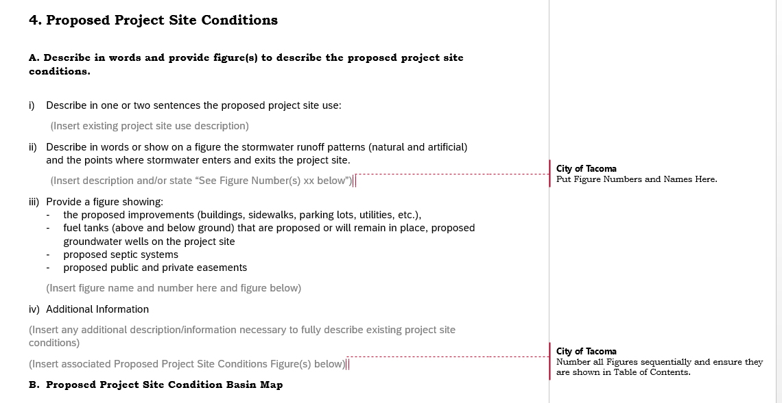
Proposed Project Site Conditions - Description
Notes:
Mieke

Slide 78
Proposed Project Site Conditions Map
Provide a proposed project site conditions basin map that shows the following areas where applicable. The map shall include a table that provides the square footage of each area described below which corresponds to the map. More than one map may be required to clearly delineate all required information.
Outline and square foot of new hard surface areas.
Outline and square footage of replaced hard surface areas.
Outline and square footage of new pollution generating hard surface areas.
Outline and square footage of replaced pollution generating hard surface areas.
Outline and square footage of hard surface areas to remain unaltered. Include grind/overlay areas, as applicable.
Outline and square footage of areas converted from vegetation to lawn/landscaped areas.
Outline and square footage of areas converted from native vegetation to pasture.
Outline and square footage of pollution generating pervious surfaces.
Outline and square footage of vegetation areas to remain unaltered.
Outline and square footage of native vegetation areas to remain unaltered.
Outline and square footage of pasture areas to remain unaltered.
Outline and square footage of lawn/landscaped areas to remain unaltered.
Outline of Threshold Discharge Areas.
*Each area should have a separate color of shading to clearly distinguish one area from another. Map, tables, and coloring/shading shall appropriately correspond.
Notes:
Mieke

Slide 79
Downstream Flowpath – Proposed Condition
**Only needed for proposed condition if TDAs change from existing to proposed condition.***
Provide a map showing the downstream flowpath from the project site to the Puget Sound – including all receiving waterbodies along the flowpath. Assume that stormwater does not infiltrate along the flowpath and will ultimately reach the Puget Sound. Include a separate map for each TDA or if each flowpath can be clearly distinguished, one map will suffice. Clearly show the ¼ mile point for determining TDA.
Notes:
Mieke

Slide 80
Questions? Please Use Q&A…and a joke!
How do you get rid of lazy tomato employees?
Can Them!!
Notes:
Mieke

Slide 81
Break 2!
Notes:
Mieke

Slide 82
Minimum Requirement Determination!!
Definitions
Flowcharts
Words in the SWMM
Proposed Project Conditions Map (Table)
Most Sensitive Receiving Waterbody
Notes:
Mieke

Slide 83
Quantifying the Project
Minimum Requirements are based upon the square footage of “impacts” to a project site.
There is no “net concept”. New hard surfaces are new hard surfaces and replaced hard surfaces are replaced hard surfaces – they both count toward thresholds.
Example – a school with a play field. An existing school that is being removed and a new school is being built on the old field – where the old school was will be the new field. The buildings are the exact same size – this does not mean there are no requirements. The new school over the existing pervious play field is a new hard surface.
Notes:
Mieke

Slide 84
Okay, the Project is Not Exempt…
Is the project considered to be new development or redevelopment?
New Development: land disturbing activities, including Class IV-General Forest Practices that are conversions from timber land to other uses; structural development, including construction or installation of a building or other structure; creation of hard surfaces; and subdivision, short subdivision and binding site plans, as defined and applied in chapter 58.17 RCW. Projects meeting the definition of redevelopment shall not be considered new development.
Redevelopment: on a site that is already substantially developed, (i.e., has 35% or more of existing hard surface coverage), the creation or addition of hard surfaces; the expansion of a building footprint or addition or replacement of a structure; structural development including construction, installation or expansion of a building or other structure; replacement of hard surface that is not part of a routing maintenance activity; and land disturbing activities.
Notes:
Mieke

Slide 85
Survey #4 – Is our project new development or redevelopment?
Coldest Ice Convenience Store – Project Reminder
Existing Conditions:
Total Project Area: 32,095 ft²
Total Onsite Lot Area: 28,195 ft²
Gravel Lot: 22,250 ft²
Blackberry Patch: 5945 ft²
Total Offsite Area: 3900 ft²
Hard Packed Dirt/Gravelly Shoulder: 1820 ft²
Existing Road: 2080 ft²
Assessed Value
Land: $509,200
Assessed Improvement: $2,700
Proposed Condition:
Onsite
New Convenience Store
Expected Average Daily Traffic (ADT): 50
New Parking Lot and Drive Aisle: 9,429 ft²
New Building (Roof Area): 8,893 ft²
Walkways: 1,123 ft²
Landscaped Areas: 8,750 ft²
Improvement Value: $750,000
Offsite Improvements:
Sidewalk Frontage: 650 ft²
Half Street Improvements: 2080 ft²
Planter Strip and Back of Walk: 1170 ft²
Example Project!
Notes:
Mieke
Merita - Poll

Slide 86
Survey #4 - Answer
It is Redevelopment! Why?
Redevelopment: on a site that is already substantially developed, (i.e., has 35% or more of existing hard surface coverage),
Existing Conditions:
Total Project Area: 32,095 Square Feet
Total Onsite Lot Area: 28,195 Square Feet
Gravel Lot: 22,250 Square Feet – Existing Hard Surface
Blackberry Patch: 5945 Square Feet
Total Offsite Area: 3900
Hard Packed Dirt/Gravelly Shoulder: 1820 – Existing Hard Surface
Existing Road: 2080 – Existing Hard Surface
Existing Hard Surface Total: 26,150 SF.
% of Total that is Existing Hard Surface = ((26150)/(32095)) * (100) = 81.5%
Example Project!
Notes:
Mieke

Slide 87
Minimum Requirement Thresholds
New Development – Site has Less than 35% Of Existing Hard Surface
Comply with Minimum Requirement #1-5 for the new and replaced hard surfaces and the land disturbed:
Results in 2,000 square feet, or greater, of new plus replaced hard surface area, or
Has land disturbing activity of 7,000 square feet or greater.
Comply with Minimum Requirements #1-#9 for the new and replaced hard surfaces and the converted vegetation areas:
Results in 5,000 square feet, or greater, of new plus replaced hard surface area, or
Converts ¾ acre or more, of vegetation to lawn or landscaped areas, or
Converts 2.5 acres, or more, of native vegetation to pasture.
Notes:
Mieke

Slide 88
Minimum Requirement Thresholds
Redevelopment– Site has 35% or more of Existing Hard Surface
Comply with Minimum Requirement #1-5 for the new and replaced hard surfaces and the land disturbed:
Results in 2,000 square feet, or greater, of new plus replaced hard surface area, or
Has land disturbing activity of 7,000 square feet or greater.
Comply with Minimum Requirements #1-#9 for the new surfaces and the converted vegetation areas:
Results in 5,000 square feet, or greater, of new plus replaced hard surface area, or
Converts ¾ acre or more, of vegetation to lawn or landscaped areas, or
Converts 2.5 acres, or more, of native vegetation to pasture.
Comply with Minimum Requirements #1-9 for the new and replaced hard surfaces and converted vegetation areas if:
The total of new plus replaced hard surfaces is 5,000 square feet or more, and
For commercial or industrial projects: the valuation of the proposed improvements, including interior improvements, exceeds 50% of the assessed value of the existing Project Site Improvements.
For all other projects: the valuation of the proposed improvements, including interior improvements, exceeds 50% of the value of the existing Site Improvements.
Notes:
Mieke

Slide 89
Which MRs Apply?
Notes:
Joy

Slide 90
Survey #5 – Which MRs must be reviewed for this project?
Coldest Ice Convenience Store – Project Reminder
Existing Conditions:
Total Project Area: 32,095 ft²
Total Onsite Lot Area: 28,195 ft²
Gravel Lot: 22,250 ft²
Blackberry Patch: 5945 ft²
Total Offsite Area: 3900 ft²
Hard Packed Dirt/Gravelly Shoulder: 1820 ft²
Existing Road: 2080 ft²
Assessed Value
Land: $509,200
Assessed Improvement: $2,700
Proposed Condition:
Onsite
New Convenience Store
Expected Average Daily Traffic (ADT): 50
New Parking Lot and Drive Aisle: 9,429 ft²
New Building (Roof Area): 8,893 ft²
Walkways: 1,123 ft²
Landscaped Areas: 8,750 ft²
Improvement Value: $750,000
Offsite Improvements:
Sidewalk Frontage: 650 ft²
Half Street Improvements: 2080 ft²
Planter Strip and Back of Walk: 1170 ft²
Example Project!
Notes:
Joy
Merita Poll

Slide 91
All Project Flowchart
Example Project!
Notes:
Joy

Slide 92
Redevelopment Flowchart
Example Project!
Proposed Condition:
Onsite Improvements
New Parking Lot and Drive Aisle: 9,429 Square Feet – New Hard Surface and Land Disturbance
New Building (Roof Area): 8,893 Square Feet – New Hard Surface and Land Disturbance
Walkways: 1,123 Square Feet – New Hard Surface and Land Disturbance
Landscaped Areas: 8,750 Square Feet – Land Disturbance
Offsite Improvements:
Sidewalk Frontage: 650 Square Feet – New Hard Surface
Half Street Improvements: 2080 Square Feet – Replaced Hard Surface
Planter Strip and Back of Walk: 1170 Square Feet – Land Disturbance
Notes:
Joy

Slide 93
Redevelopment Flowchart
Example Project!
Whether or not the project has to review Minimum Requirement #6-9 for the project depends on the valuation of the project.
Redevelopment projects are only required to be brought up to certain standards if additional thresholds are met.
Not the case with new development projects.
Notes:
Joy

Slide 94
Minimum Requirement Determination Tables
Notes:
Mieke

Slide 95
Project Threshold Table
www.cityoftacoma.org/stormwatermanual_templates
Quantifies your project.
Also on the project existing and proposed basin maps.
Needed for determining what MRs apply to the project.
Notes:
Mieke
Bring up table from website.

Slide 96
Cumulative Impacts Table
www.cityoftacoma.org/stormwatermanual_templates
Used for determining what MRs apply to the project.
Remember project is based upon what has occurred on the site since 2003.
Only need to include information relevant to MR determination.
Developing Tip Sheet/Additional Guidance about this subject.
Notes:
Mieke
Bring up table from website.

Slide 97
Receiving Waterbody Table
How to determine the type of receiving waterbody?
tMap provides some basic information but also Ask Us! What is shown might not be up to date or might not be relevant to SWMM compliance. ^{(map example)}
Notes:
Bring up table from website.
Joy
tMap showing downstream follow-the-arrows to see where site discharges to

Slide 98
Discharge Location and Threshold Discharge Areas
Minimum Requirement #5, #6, #7, and #8 compliance is based upon the discharge location.
Minimum Requirement #6, #7, #8 compliance is based upon the development that occurs within a threshold discharge area.
Notes:
Mieke
Previously we learned that MR #1-9 must be reviewed for this project and they apply to the new and replaced hard surfaces. Now we want to determine if 6, 7, 8 apply and then how to apply MR #5.

Slide 99
Where is the Project?
Minimum Requirements (MR #5, MR#6, MR#7, MR#8) are based upon the most sensitive receiving waterbody encountered downstream from the project site.
A receiving waterbody – naturally and/or reconstructed naturally occurring surface water bodies, such as creeks, streams, rivers, lakes, wetlands, estuaries, and marine waters, or groundwater, to which a stormwater system discharges.
“Most sensitive for SWMM.”
Wetlands
Waterbodies that are Not Flow Control Exempt Waterbodies
Flow Control Exempt Waterbodies
Common mistake – not knowing every receiving waterbody which means not knowing which is most sensitive waterbody and not selecting the correct MRs.
Notes:
Mieke

Slide 100
Flow Control Exempt
A project is flow control exempt if stormwater from that project discharges directly or indirectly to saltwater bodies, or the Puyallup River and all the following restrictions are met:
Direct discharge to the saltwater body, or the Puyallup River does not result in the diversion of stormwater and surface water from any perennial stream classified as Types 1, 2, 3, or 4 in the State of Washington Interim Water Typing System, or Types "S", "F", or "Np" in the Permanent Water Typing System, or from any category I, II, or III wetland.
If flow splitters or conveyance elements are applied to route natural runoff volumes from the project to any downstream Type 5 stream or category IV wetland, then:
Design of the flow splitters or conveyance elements must be based on approved continuous simulation modeling analysis. The design must assure that flows delivered to Type 5 stream reaches will approximate, but in no case exceed, durations ranging from 50% of the 2-year to the 50-year peak flow.
Flow splitters and conveyance elements that deliver flows to category IV wetlands must also be designed using approved continuous simulation modeling to preserve pre-project wetland hydrologic conditions unless specifically waived or exempted by regulatory agencies with permitting jurisdiction.
Stormwater and surface water from the project (or TDA) must discharge to a conveyance system that is comprised entirely of artificial conveyance elements (e.g., pipes, ditches, outfall protection) and extends to the ordinary high water line of the exempt receiving water.
The conveyance system between the project and the exempt receiving water shall have sufficient hydraulic capacity to convey discharges from future build-out conditions (under current zoning) from contributing areas of the Site, and the existing conditions from contributing off-site areas. (For MR determination (not Additional Protective Measure) assume there is always sufficient hydraulic capacity in the City of Tacoma system).
Any erodible elements of the artificial conveyance system must be adequately stabilized to prevent erosion under the conditions noted above.
Notes:
Mieke

Slide 101
Survey #6 – Is our project flow control exempt?
Example Project!
Notes:
Mieke

Slide 102
Threshold Discharge Areas
MR #6, MR#7, MR#8 apply to Threshold Discharge Areas.
An onsite area draining to a single natural or constructed discharge location or multiple natural or constructed discharge locations that converge within one-quarter mile downstream (as determined by the shortest flowpath). The examples in Figure G - 1: Threshold Discharge Area illustrate this definition.
The purpose of this definition is to clarify how the thresholds of this manual are applied to project sites with multiple discharge locations.
When determining which Minimum Requirements apply to a project, it shall be assumed that stormwater leaves the project site (ex. an area that infiltrates is not considered a separate TDA from another area of the project site).
Notes:
Mieke

Slide 103
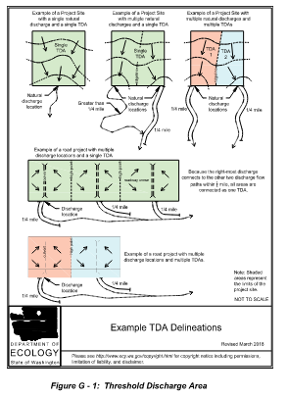
Notes:
Mieke

Slide 104
What 2 TDAs Might Look Like
Notes:
Mieke

Slide 105
Questions? Please Use Q&A…and a joke!
What’s red and completely invisible?
No tomatoes!!
Notes:
Mieke

Slide 106
MR #6 – Stormwater Treatment
When assessing a project against the following thresholds, only consider those surfaces that are subject to this Minimum Requirement as determined in Applicability of the Minimum Requirements.
The following require construction of stormwater treatment facilities:
TDAs in which the total of pollution-generating hard surface (PGHS) is 5,000 square feet or more in a threshold discharge area of the project, or
TDAs in which the total of pollution-generating pervious surfaces (PGPS) - not including permeable pavements - is three-quarters (¾) of an acre or more in a threshold discharge area, and from which there will be a surface discharge in a natural or artificial conveyance system from the TDA.
Projects that infiltrate stormwater in the South Tacoma Groundwater Protection District have additional and/or different thresholds and requirements for stormwater treatment. See the South Tacoma Groundwater Protection District Infiltration Policy available at https://www.tpchd.org/healthy-places/waste-management/business-pollution-prevention/south-tacoma-groundwater-protection-district for additional information.
Notes:
Mieke
We already learned that we have to review MRs #1-9 for the new and replaced hard surfaces and converted vegetation areas. And we always have to review Additional Protective Measure – Infrastructure Protection. What does this all mean?

Slide 107
Survey #7 – Is Treatment Required?
Coldest Ice Convenience Store – Project Reminder
Assume One Threshold Discharge Area
Existing Conditions:
Total Project Area: 32,095 ft²
Total Onsite Lot Area: 28,195 ft²
Gravel Lot: 22,250 ft²
Blackberry Patch: 5945 ft²
Total Offsite Area: 3900 ft²
Hard Packed Dirt/Gravelly Shoulder: 1820 ft²
Existing Road: 2080 ft²
Assessed Value
Land: $509,200
Assessed Improvement: $2,700
Proposed Condition:
Onsite
New Convenience Store
Expected Average Daily Traffic (ADT): 50
New Parking Lot and Drive Aisle: 9,429 ft²
New Building (Roof Area): 8,893 ft²
Walkways: 1,123 ft²
Landscaped Areas: 8,750 ft²
Improvement Value: $750,000
Offsite Improvements:
Sidewalk Frontage: 650 ft²
Half Street Improvements: 2080 ft²
Planter Strip and Back of Walk: 1170 ft²
Example Project!
Notes:
Mieke
Merita - Poll

Slide 108
Why is Stormwater Treatment Required?
Example Project!
Project is required to review MR#6 for the new and replaced hard surfaces and converted vegetation areas and there is greater than 5,000 square feet and new and replaced pollution generating hard surface area.
Proposed Condition:
Onsite
New Convenience Store
Expected Average Daily Traffic (ADT): 50
New Parking Lot and Drive Aisle: 9,429 ft² - This is pollution generating hard surface.
New Building (Roof Area): 8,893 ft²
Walkways: 1,123 ft²
Landscaped Areas: 8,750 ft²
Improvement Value: $750,000
Offsite Improvements:
Sidewalk Frontage: 650 ft²
Half Street Improvements: 2080 ft² - This is pollution generating hard surface.
Planter Strip and Back of Walk: 1170 ft²
Notes:
Mieke

Slide 109
MR #7 – Flow Control
Threshold Discharge Areas (TDAs) that are not Flow Control Exempt TDAs within a project that meet or exceed any of the following thresholds shall provide Flow Control Mitigation.
Threshold Discharge Areas (TDAs) that have a total of 10,000 square feet or more of effective impervious surface, or
TDAs that convert ¾ acres or more of vegetation to lawn or landscaped area and from which there is a surface discharge in natural or artificial conveyance systems from the TDA, or
TDAs that convert 2.5 acres or more of native vegetation to pasture and from which there is a surface discharge in natural or artificial conveyance systems from the TDA, or
TDAs that, through a combination of effective hard surfaces and converted vegetation areas, cause a 0.15 cfs or greater increase in the 100-year return period flowrate as estimated using an approved continuous simulation model with 15 minute timesteps. Comparison of flowrates shall be between existing and proposed project site land cover conditions.
Notes:
Mieke

Slide 110
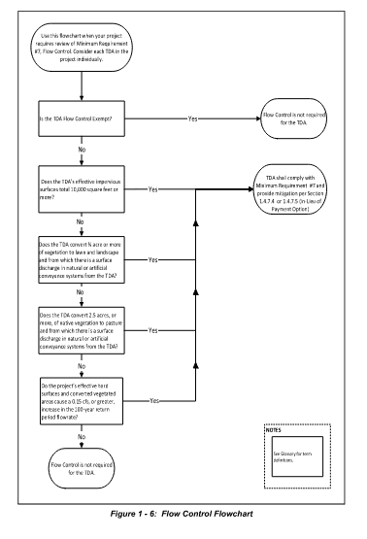
Notes:
Mieke

Slide 111
Survey #8 – Is Flow Control Required?
Coldest Ice Convenience Store – Project Reminder
Assume One Threshold Discharge Area
Existing Conditions:
Total Project Area: 32,095 ft²
Total Onsite Lot Area: 28,195 ft²
Gravel Lot: 22,250 ft²
Blackberry Patch: 5945 ft²
Total Offsite Area: 3900 ft²
Hard Packed Dirt/Gravelly Shoulder: 1820 ft²
Existing Road: 2080 ft²
Assessed Value
Land: $509,200
Assessed Improvement: $2,700
Proposed Condition:
Onsite
New Convenience Store
Expected Average Daily Traffic (ADT): 50
New Parking Lot and Drive Aisle: 9,429 ft²
New Building (Roof Area): 8,893 ft²
Walkways: 1,123 ft²
Landscaped Areas: 8,750 ft²
Improvement Value: $750,000
Offsite Improvements:
Sidewalk Frontage: 650 ft²
Half Street Improvements: 2080 ft²
Planter Strip and Back of Walk: 1170 ft²
Example Project!
Notes:
Mieke
Merita – Poll

Slide 112
Why is Flow Control Required?
Project is required to review MR#6 for the new and replaced hard surfaces and converted vegetation areas and there is greater than 10,000 square feet of effective impervious surface.
Proposed Condition:
Onsite
New Convenience Store
Expected Average Daily Traffic (ADT): 50
New Parking Lot and Drive Aisle: 9,429 ft² - This is effective impervious.
New Building (Roof Area): 8,893 ft² - This is effective impervious.
Walkways: 1,123 ft² – This is effective impervious.
Landscaped Areas: 8,750 ft²
Improvement Value: $750,000
Offsite Improvements:
Sidewalk Frontage: 650 ft² – This is effective impervious.
Half Street Improvements: 2080 ft² - This is effective impervious.
Planter Strip and Back of Walk: 1170 ft² - This is effective impervious.
Example Project!
Notes:
Mieke

Slide 113
MR #8 – Wetlands Protection
TDAs within projects that meet the thresholds for Minimum Requirement #8 and discharge stormwater directly or indirectly to a wetland must provide Wetlands Protection. See Figure 1 - 7: Determining Required Wetland Protection Levels to determine which Level of Wetland Protection applies to a project.
Notes:
Mieke

Slide 114
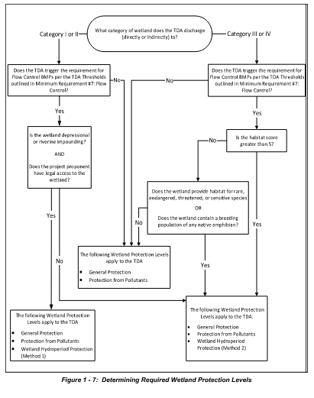
Notes:
Mieke

Slide 115
How to Determine Wetland Type?
Use tMap. ^{(map example)}
Ask us. We are working to make this information more readily available when possible.
If unknown, up to applicant to determine the wetland type per “Washington State Wetland Rating System for Western Washington”.
Notes:
Joy
tMap – wetlands layer. Show the not-wetlands layer too.

Slide 116
Survey #9 – Is Wetlands Protection Required for the project?
Example Project!
Receiving Waterbody Name | Type of Receiving Waterbody
Hosmer Holding Basin | Stormwater Facility - Not Receiving Waterbody
Ward's Lake | Lake
Gravel Pit | Stormwater Facility - Not Receiving Waterbody
Flett Creek | Creek
Chambers Creek | Creek
Puget Sound | Marine
Notes:
Mieke
Merita - Poll

Slide 117
Questions? Please Use Q&A…and a joke!
Why did the tomato blush?
Because it saw the salad dressing!!
Notes:
Mieke

Slide 118
Lunch Time!
Notes:
Make ourselves available for a little bit here.

Slide 119
Minimum Requirement Discussion and Compliance
Minimum Requirement #1 – Preparation of a Stormwater Site Plan
Report and plan set that describe the existing project site conditions and present how stormwater will be managed for the proposed conditions.
Long Form and Short Form Template
Short Form for Projects that Trigger MR#1-5 Only.
We are currently using the long form for our project!!
Notes:
Mieke

Slide 120
Minimum Requirement Discussion and Compliance
Minimum Requirement #2 – Construction Stormwater Pollution Prevention Plan
All projects are responsible to prevent erosion and discharge of sediment and other pollutants into receiving waters.
Projects that trigger MR#2 must complete a SWPPP Report and plan set.
SWPPP describes how stormwater will be managed during construction. 13 Elements that must be addressed.
Element #1: Preserve Vegetation and Mark Clearing Limits
Element #2: Establish Construction Access
Element #3: Control Flow Rates
Element #4: Install Sediment Controls
Element #5: Stabilize Soils
Element #6: Protect Slopes
Element #7: Protect Stormwater System Inlets
Element #8: Stabilize Channels and Outlets
Element #9: Control Pollutants
Element #10: Control Dewatering
Element #11: Maintain BMPs
Element #12: Manage the Project
Element #13: Protect Permanent Stormwater BMPs
Long Form Construction Stormwater Pollution Prevention Form Available.
Short Form Construction SWPPP is combined with Short Form SSP.
Notes:
Mieke

Slide 121
MR #2 – Common Misses
Not describing why an Element is not required.
Not providing BMPs that will be used to meet the element.
Describing BMPs in the report but not showing them on the plan set.
Use ECY template for Construction Stormwater General Permit but do not alter to remove sampling and monitoring.
CESCL is required but the listed person’s CESCL certification has expired.
Notes:
Mieke

Slide 122
Minimum Requirement Discussion and Compliance
Minimum Requirement #3 – Source Control
All known, available and reasonable source control BMPs shall be applied to all projects. Source control BMPs shall be selected, designed, and maintained according to Volume 6 of this manual. Structural and operational source control BMPs shall be identified in the stormwater site plan report and structural source control BMPs shall be shown on construction plans submitted for City review.
BMPs for final site use intended to prevent stormwater from coming in contact with pollutants.
Spreadsheet to Help Pick Appropriate BMPs based on final site activity.
Common Mistake – including TESC BMPs in this section instead of under MR#2.
Notes:
Mieke

Slide 123
What Does MR #3 Look Like?
Hardware Store
Sweeping
Covering Garbage Bins
Keeping Outside Soils/Fertilizers Covered
Industrial Site
Secondary Containment
Conducting Activities/Processes Inside
Sweeping
Structural BMP – Some Crazy Thing to Meet specific Industrial (etc.) Permit Limits
Notes:
Mieke
A little time about industrial permit and demonstrative approach.

Slide 124
Our Project – MR#3
Example Project!
Notes:
Mieke

Slide 125
Minimum Requirement Discussion and Compliance
MR#4 – Preserving Drainage Patterns and Outfalls
For all projects, the natural and/or existing condition drainage patterns shall be maintained and discharges from the project site shall occur at the natural and/or existing discharge location to the maximum extent practicable. Natural drainage patterns must always be maintained where natural drainage patterns exist. Note: Compliance with other Minimum Requirements may create a scenario with no discharge due to the use of stormwater management facilities that fully infiltrate - this Minimum Requirement is not meant to require stormwater discharges from a site.
Stormwater shall discharge to the same receiving waterbody in the existing and final condition.
All outfalls shall have energy dissipation BMPs designed per A400: Outfall Systems.
Notes:
Mieke

Slide 126
Minimum Requirement Discussion and Compliance
Minimum Requirement #4 – Preserving Drainage Patterns and Outfalls (Slide 2)
Stormwater shall not cause adverse impacts to downgradient properties or to the receiving waters. To accomplish this the City will allow discharges as follows:
Stormwater that has not been concentrated and that has not increased in volume or flowrate as a result of the project, may discharge onto neighboring private parcels, into the City Right-of-Way or other City owned parcels, or into neighboring jurisdictions Right-of-Way without additional constraints.
Concentrated stormwater and/or stormwater that has increased in volume or flowrate may be discharged onto neighboring private properties or neighboring jurisdiction Right-of-Way provided consultation with the neighboring private property owner and/or neighboring jurisdiction has taken place. Proof of consultation shall be provided to the City. Guidance for the type of energy dissipation must be followed.
Concentrated stormwater and/or stormwater that has increased in volume or flowrate may be discharged to the City of Tacoma stormwater system provided sufficient capacity is available within that system and with approval from the City of Tacoma. See Additional Protective Measure - Infrastructure Protection to determine if an analysis of the downstream system is required for the project. The City of Tacoma stormwater system may need to be extended to serve the site - see Volume 5 - Stormwater Conveyance Design and Protection for additional information.
Notes:
Mieke

Slide 127
Our Project – MR#4
Example Project!

Slide 128
Minimum Requirement Discussion and Compliance
MR#5 – Onsite Stormwater Management
Projects shall employ Stormwater Management BMPs to infiltrate, disperse, and retain stormwater onsite to the extent feasible without causing flooding or erosion impacts.
Use either: The List Approach or The LID Performance Standard
Notes:
Mieke

Slide 129
MR#5 – The List Approach
Analyze BMPs from a preset list for feasibility to use onsite. If the BMP is feasible it shall be used for that surface type. If BMPs are not feasible it may be possible to collect and convey to the City system.
Feasibility determined by evaluation against design criteria, limitations, and infeasibility criteria identified for each BMP and competing needs criteria.
BMPs must be analyzed in order presented in the table.
List #1: Projects that Trigger Only Minimum Requirement #1-5 – Not Flow Control Exempt
List #2: Project that Trigger Minimum Requirement #1-9 – Not Flow Control Exempt.
List #3: Flow Control Exempt Projects
Use Infeasibility Checklists to Analyze BMPs for feasibility.
Notes:
Mieke

Slide 130
Survey #10 – What List Should we Use for the List Approach?
Example Project!
Coldest Ice Convenience Store – Project Reminder
Not Flow Control Exempt
Required to Comply with Minimum Requirements #1, 2, 3, 4, 5, 6, 7, 9
Notes:
Mieke
Merita - Poll

Slide 131
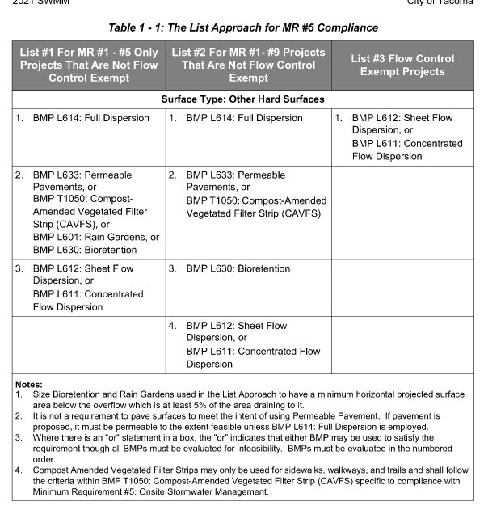
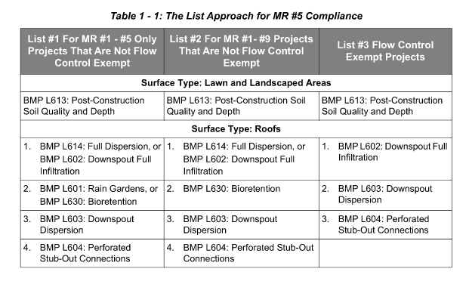
Notes:
Mieke

Slide 132
MR #5 – LID Performance Standard
The LID Performance Standard allows for the use of any BMPs sited throughout the project site that when modeled meet the LID Performance Standard. The LID Performance Standard allows for a more flexible site design.
The LID Performance Standard requires modeling by a Washington State Licensed Professional Engineer. The modeling outputs shall be included in the Stormwater Site Plan Report. See Volume 2 - Documentation for additional information on what is required for modeling outputs.
Utilize one or a combination of Flow Control BMPs to meet the flow reduction modeling standards below. Rain Gardens cannot be used to achieve the LID Performance Standard though Bioretention may be used provided it is designed to provide flow control.
Notes:
Mieke

Slide 133
MR #5 – LID Performance Standard
Using an Ecology approved continuous simulation model (assuming a 15-minute timestep) for design, stormwater discharges shall match developed discharge durations to predeveloped discharge durations for the range of predeveloped discharge rates from 8% of the 2-year return period flowrate to 50% of the 2-year return period flowrate. Projects required to comply with Minimum Requirement #7 must match developed discharge durations to predeveloped discharge durations for the range of predeveloped discharge rates from 8% of the 2-year return period flowrate up to the full 50-year return period flowrate.
The predeveloped condition to be matched shall be a forested land cover condition unless:
Reasonable historic information is provided that indicates the site was prairie prior to settlement.
Note: an applicant may submit this historical information as part of the Stormwater Site Plan Report for any given project.
In this case, the predeveloped condition to be matched can be modeled as pasture.
The project is located within an area which has been verified to have 40% Total Impervious Area as of 1985 (the drainage area of the immediate stream and all subsequent downstream basins have had at least 40% total impervious area (TIA) since 1985). Figure 1 - 4: 40% Total Impervious Area as of 1985 depicts those areas meeting the criteria. The City of Tacoma tMap also has a layer showing these areas.
Note: only the approved map determines these areas. Additionally areas cannot be added on a case by case basis. In this case, the predeveloped condition to be matched can be the existing land cover condition.
Notes:
Mieke

Slide 134
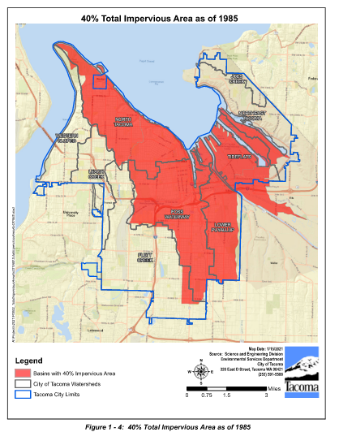
Notes:
Mieke

Slide 135
What to Submit – MR#5
If using the List Approach:
State the BMPs being used for each surface type. Provide the BMP name(s) and number(s) from the SWMM.
Include the infeasibility checklist for any BMPs deemed infeasible.
Include a reference to associated documents used for determining infeasibility such as Soils Report, survey showing project site topography, maps showing distance to property lines, etc.
Provide sizing calculations for all BMPs proposed.
Infeasibility checklists are available at www.cityoftacoma.org/stormwatermanual_templates. Include only the infeasibility checklists necessary for the project.
Facility sizing sheets can be found at www.cityoftacoma.org/stormwatermanual_templates.
If using the LID Performance Standard
State the BMPs being used for compliance. Provide the BMP name(s) and number(s).
State that BMP L613: Post-Construction Soil Quality and Depth is being used.
Provide sizing calculations for all BMPs proposed.
Provide the modeling report showing that with the use of BMPs, the LID Performance Standard is met. Include modeling report as appendix to the SSP.
Notes:
Mieke

Slide 136
MR #5 – Infeasibility Checklists
No need to answer all questions. Unless otherwise noted, a single answer of No means the BMP is infeasible.
Certain criteria require specific expertise like P.E. or soils report.
Notes:
Mieke

Slide 137
MR #5 – List Approach Sizing Sheets
Notes:
Mieke
Cannot be used alone for the LID Performance Standard. Must also have continuous simulation modeling.

Slide 138
MR#5 – Common Mistakes
Not using infeasibility criteria contained within the SWMM.
Just stating infiltration is not feasible. This is not an infeasibility criteria.
Not including supporting materials for infeasibility such as soils report, setback information, etc.
Sizing information not included for feasible BMPs.
Not including full WWHM report to substantiate LID Performance Standard.
Notes:
Mieke

Slide 139
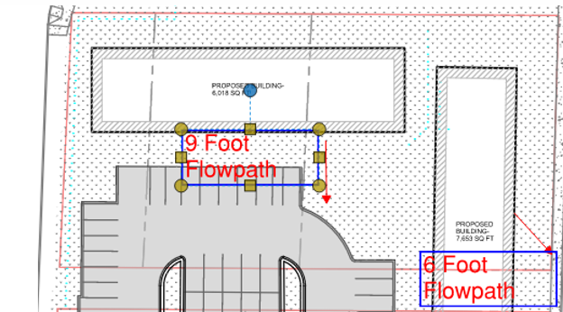
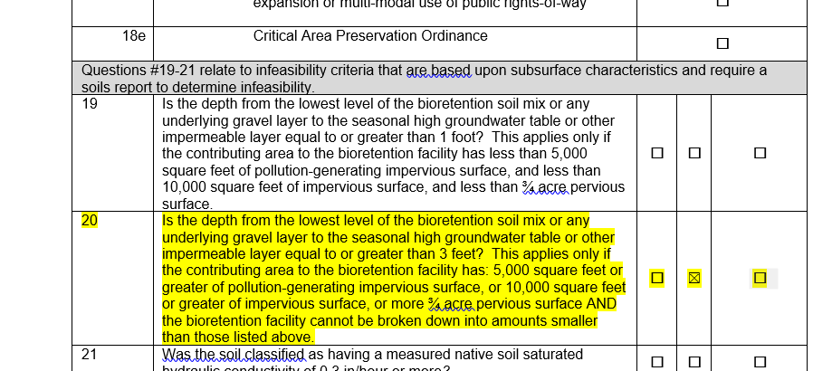
Our Project MR#5
Example Project!
Notes:
Mieke

Slide 140
Questions? Please Use Q&A…and a joke!
What looks like a half tomato?
The other half!!
Notes:
Mieke

Slide 141
Break
Notes:
Mieke

Slide 142
MR #6 – Stormwater Treatment
Type of treatment required is based upon the project scope and receiving waterbody.
Oil Control BMPs are required for areas within a project site that generate high concentrations of oil due to high traffic turnover or the frequent transfer of oil. Areas that require oil control include:
Areas of commercial or industrial sites subject to an expected average daily traffic (ADT) count equal to or greater than 100 vehicles per 1,000 square feet of gross building area, or 300 total trip ends per day.
Areas of commercial or industrial sites subject to petroleum storage and transfer in excess of 1,500 gallons per year, not including routinely delivered heating oil.
Areas of commercial or industrial sites subject to parking, storage, or maintenance of 25 or more vehicles that are over 10 tons gross weight (trucks, buses, trains, heavy equipment, etc.).
A road intersection with a measured ADT count of 25,000 vehicles or more on the main roadway and 15,000 vehicles or more on any intersecting roadway, excluding projects proposing primarily pedestrian or bicycle use improvements.
Traffic count shall be based upon the prepared traffic study if one was required for the project. If a traffic study was not required, the traffic count can be estimated using information from the most recent Trip Generation Manual.
Notes:
Mieke

Slide 143
MR #6 – Stormwater Treatment
Type of treatment required is based upon the project scope and receiving waterbody.
Phosphorus Treatment
Phosphorus treatment is required for projects within watersheds that are sensitive to phosphorus and are being managed to control phosphorus. Direct and indirect discharges to Wapato Lake require phosphorus treatment when thresholds for Minimum Requirement #6 are met.
Notes:
Mieke

Slide 144
MR #6 – Stormwater Treatment
Enhanced Treatment
Enhanced treatment is required for industrial, commercial, multi-family, and/or high ADT roads that:
Discharge directly to fresh waters designated for aquatic life use or that have an existing aquatic life use; or
Discharge to conveyance systems that are tributary to fresh waters designated for aquatic life use or that have an existing aquatic life use; or
Infiltrate stormwater within ¼ mile of fresh waters designated for aquatic life use or that have an existing aquatic life use.
Even if all the thresholds above are met, enhanced treatment is not required for:
Direct or indirect discharges to the Puyallup River;
Landscaped areas of industrial, commercial, and/or multi-family project sites that do not involve any other pollution-generating sources (ex. industrial activities, customer parking, storage of erodible or leachable materials, wastes, or chemicals); or
Parking lots of industrial and commercial project sites dedicated solely to parking employee's private vehicles that do not involve any other pollution-generating sources (ex. industrial activities, customer parking, storage of erodible or leachable materials, wastes, or chemicals).
For threshold discharge areas within a project site with a mix of land use types, enhanced treatment is required when the runoff from the areas subject to enhanced treatment comprise 50% or more of the total runoff from the threshold discharge area. If the area subject to enhanced treatment is less than 50% of the total runoff from the threshold discharge area, only basic treatment is required.
For the purpose of determining when enhanced treatment is applied, ADT shall include:
• Fully controlled and partially controlled limited access highways with Average Daily Traffic (ADT) counts of 15,000 or more;
• All other roads with an ADT of 7,500 or greater
Notes:
Mieke

Slide 145
MR #6 – Stormwater Treatment
Aquatic life uses are based upon the presence of, or intent to provide protection for:
char spawning and rearing,
core summer salmonid habitat,
salmonid spawning, rearing, and migration,
salmonid rearing and migration only,
non-anadromous interior redband trout,
indigenous warm water species,
all indigenous fish and nonfish aquatic species.
In the City of Tacoma, all freshwater bodies shall be considered to have an aquatic life use. See Volume 1, Minimum Requirement #6 to determine what treatment type applies to the project.
Notes:
Mieke

Slide 146
MR #6 – Stormwater Treatment
Basic Treatment
Areas that provide phosphorus treatment or enhanced treatment do not have to provide additional basic treatment. Phosphorus and enhanced treatment best management practices provide basic treatment.
Basic treatment is required for all areas within a project site that meet the stormwater treatment thresholds but are not required to provide enhanced treatment and/or phosphorus treatment.
Pretreatment
Pretreatment best management practices are required:
When utilizing the following BMPs:
BMP T808: Basic Sand Filter
BMP T809: Large Sand Filter
BMP T810: Sand Filter Vault
BMP 700: Infiltration - Basins, Trenches, and Drywells
Where the basic, phosphorus, or enhanced stormwater treatment BMP or the receiving waterbody may be adversely impacted by non-targeted pollutants or may be overwhelmed by a heavy load of targeted pollutants.
Notes:
Mieke

Slide 147
Survey #11 – What type of treatment is required?
Example Project!
Receiving Waterbody Name | Type of Receiving Waterbody
Hosmer Holding Basin | Stormwater Facility - Not Receiving Waterbody
Ward's Lake | Lake
Gravel Pit | Stormwater Facility - Not Receiving Waterbody
Flett Creek | Creek
Chambers Creek | Creek
Puget Sound | Marine
New Convenience Store
Expected Average Daily Traffic (ADT): 50 vehicles/day
New Parking Lot and Drive Aisle: 9,429 ft²
New Building (Roof Area): 8,893 ft²
Notes:
Mieke
Merita - Poll

Slide 148
Survey 11 – Why?
Not quite enough information.
Oil Control: Areas of commercial or industrial sites subject to an expected average daily traffic (ADT) count equal to or greater than 100 vehicles per 1,000 square feet of gross building area, or 300 total trip ends per day.
Didn’t provide with gross building area but we’ll assume a little less than the roof area for purposes here: 50/8500 < 100/1000.
We do not know the total trip ends so would need this additional information.
Enhanced Treatment required because this is a commercial use that is discharging to a freshwater body so aquatic life use.
Notes:
Mieke

Slide 149
MR #6 – What to Submit
Description of why the project must comply with the MR. Describe for each TDA.
Description of treatment type required.
Stormwater treatment basin map.
Outline and square footage of areas requiring treatment.
Outline and square footage of areas receiving treatment.
Outline and square footage of areas receiving treatment that is pollution generating.
Outline and square footage of areas bypassing treatment.
Outline and square footage of areas bypassing treatment that are pollution generating
Description of BMP being used including:
Provide BMP name(s) and number(s) from the City of Tacoma SWMM.
Provide sizing calculations (including modeling report used for calculation) for all BMPs proposed. Provide calculations in appendix.
If an Emerging Technology is proposed, include the most current Use Level Designation as an attachment/appendix to the SSP Report.
Notes:
Mieke

Slide 150
MR #6 – Common Misses
No stormwater treatment basin map.
WWHM Report included but no sizing information included.
Notes:
Mieke

Slide 151
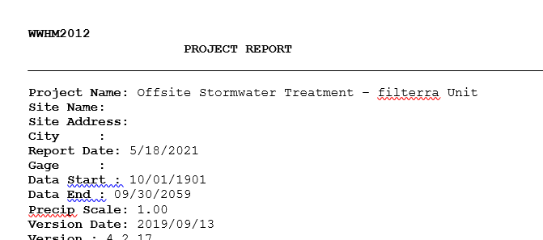
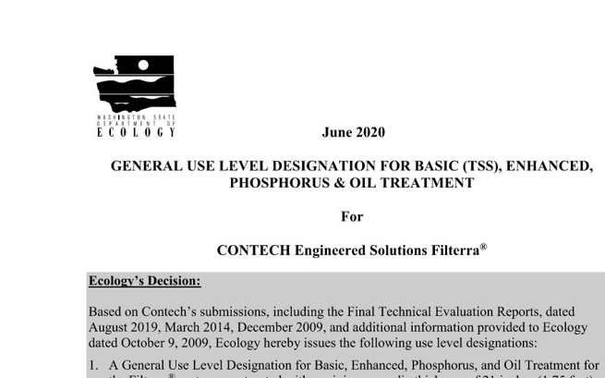
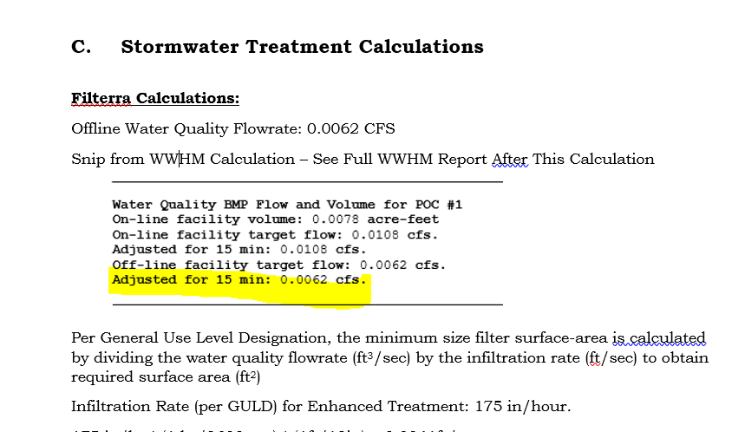
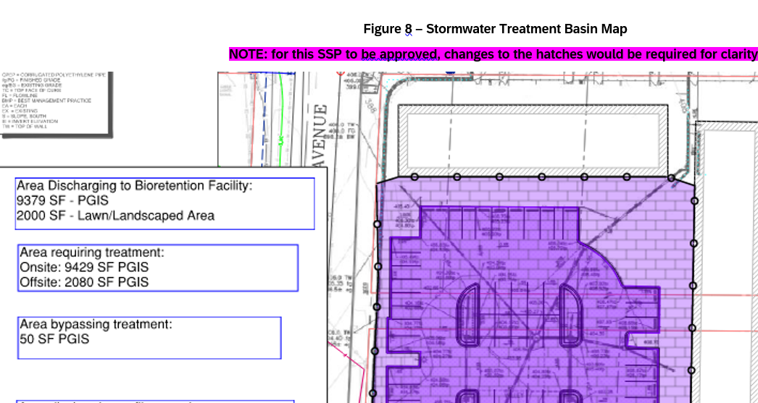
Our Project – MR#6
Example Project!
Notes:
Mieke

Slide 152
MR #7 – Flow Control
Stormwater discharges shall match developed discharge durations to predeveloped durations for the range of predeveloped discharge rates from 50% of the 2-year peak flow up to the full 50-year peak flow. The predeveloped condition to be matched shall be a forested land cover unless:
Reasonable, historic information is provided that indicates the site was prairie prior to settlement (modeled as pasture in the approved continuous simulation model); or,
The drainage area of the immediate stream and all subsequent downstream basins have had at least 40% total impervious area since 1985. In this case, the predeveloped condition to be matched shall be the existing land cover condition.
Notes:
Mieke

Slide 153
MR #5 and MR#7 Relationship
BMPs required for MR#5 compliance can help attain MR#7 compliance.
Residential roofs that are infiltrated according to manual are considered ineffective so help attain compliance.
A suite of onsite management BMPs may completely attain MR#7 compliance negating the need for a detention facility or may help to make that facility smaller.
Only certain MR#5 BMPs have “flow credits”.
Rain Gardens do not provide flow control credits so couldn’t help achieve MR#7 but bioretention without an underdrain could.
Notes:
Mieke

Slide 154
MR #7 – What to Submit
Description of why the project must comply with the MR. Describe for each TDA.
Description of flow control type required.
Flow control basin map.
Outline and square footage of areas requiring flow control.
Outline and square footage of areas receiving flow control.
Outline and square footage of areas bypassing flow control.
Description of BMP being used including:
Provide BMP name(s) and number(s) from the City of Tacoma SWMM.
Provide sizing calculations for all BMPs proposed. Provide calculations in an appendix.
Provide modeling report showing the Performance Standard has been met.
Notes:
Mieke

Slide 155
MR #7 – Common Misses
No flow control basin map.
WWHM Report included but no sizing information included.
Performance Standards are not clearly shown to have been met.
Incorrect continuous simulation model element used. For example: Arched detention tanks are modeled as vaults or ponds.
Notes:
Mieke

Slide 156
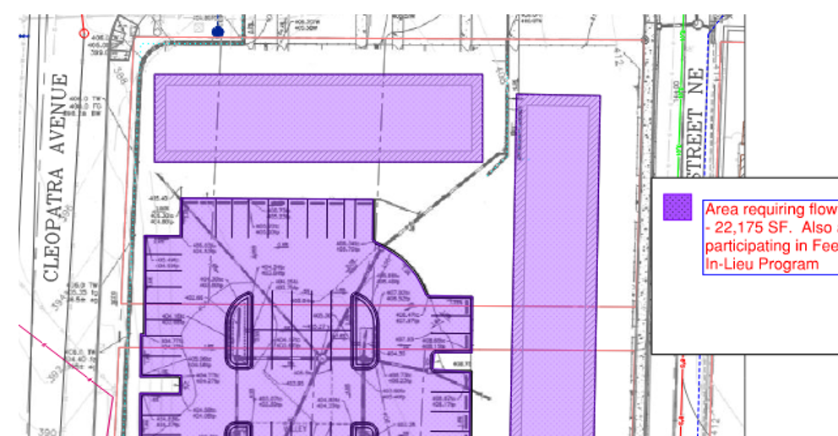
Our Project – MR#7
Example Project!
Notes:
Mieke

Slide 157
Wetland Protection Levels
General Protection
General Practices that Benefit Wetlands of All Types
Protection from Pollutants
Measures to Protect the Wetland from Pollutants in Stormwater Runoff.
Wetland Hydroperiod Protection
Method 1 – Monitoring and Wetland Stage Modeling
Data collection specific to the wetland and continuous simulation modeling to demonstrate that the proposed project will not negatively alter the wetland hydrology. Potentially one year of monitoring required.
Ecology created a spreadsheet that takes output from WWHM and evaluates for Method 1.
Method 2 – Site Discharge Modeling
Continuous simulation modeling of the runoff from the TDA to demonstrate that the changes in total discharge volume to the wetland will remain similar to the predevelopment condition.
WWHM has a module to calculate impacts.
Notes:
Mieke

Slide 158
MR #8 – What to Submit
Description of why the project must comply with the MR. Describe for each TDA.
Description of level of protection required.
Include wetland delineation report as attachment/appendix.
Include all wetland hydrology calculations. Provide calculations (and associated modeling report) as appendix.
Provide existing and proposed basin maps that clearly show land use conditions and acreages (or square feet) used in the analysis.
Provide sizing calculations for all BMPs proposed. Provide calculations (and associated modeling report) as appendix.
Modeling Report must clearly show required level of protection is met.
If an Emerging Technology is proposed, include the most current Use Level Designation as an attachment/appendix to the SSP Report.
Provide a stormwater treatment or flow control basin map or both. Does not have to be different from basin maps included with stormwater treatment or flow control sections – include references as needed.
Notes:
Mieke

Slide 159
MR #9 – Operation and Maintenance
Require an Operation and Maintenance Manual for all proposed permanent stormwater BMPs.
Stand-alone document.
Must identify party responsible for maintenance.
Copy must be kept onsite or within reasonable access to site.
O&M must be transferable to new property owner.
Covenant and Easement (C&E) Agreements
A legal means to ensure maintenance is performed on private properties.
Allows City access to the facilities for inspection
Recorded to title.
Required for all proposed permanent stormwater BMPs.
Notes:
Mieke

Slide 160
MR #9 – What to Submit
A narrative description of the stormwater facilities.
An 11 x 17 inch site plan, with the locations of the stormwater facilities (including conveyance) prominently noted. This is needed to enable the Operation and Maintenance Manual to be a stand-alone document.
Not required for facilities that will be maintained by the City and located in the public right-of-way because the facility plans are uploaded to the City of Tacoma system.
Detail drawings of the proposed facilities including overall dimensions and locations of inflow, bypass, and discharge.
The person or organization responsible for maintenance of the onsite storm system, including the phone number and current responsible party.
Where the Operation and Maintenance Manual is to be kept. Note that it must be made available to the City for inspection. The Operation and Maintenance Manual shall be onsite prior to Certificate of Occupancy.
A description of each stormwater facility, including what it does and how it works. Include any manufacturer’s documentation and recommendations. For City maintained facilities located in the public right of way, do not include manufacturer's documentation and recommendations as part of the submittal.
A description of all maintenance tasks and the frequency of each task for each facility. Include any manufacturer’s recommendations. For City maintained facilities located in the Public Right of Way, do not include this with the submittal.
A sample maintenance activity log indicating emergency and routine actions to be taken.
It is recommended to include a cost estimate for maintenance of each facility.
Template available!
Don’t forget that before Permit issuance you will need to Covenant and Easement Agreement Process.
Notes:
Mieke

Slide 161
MR #9 – Common Misses
Figure showing facility location not included.
Figure does not obviously show where facilities are located.
Contact information for person responsible for maintenance not included.
Maintenance schedules do not match use level designation for proprietary devices.
Covenant and Easement Agreement not complete.
Notes:
Mieke

Slide 162
Questions? Please Use Q&A…and a joke!
What type of tomato smells best?
A Roma!!
Notes:
Mieke

Slide 163
Home Stretch Break!!!
Notes:
Play Music

Slide 164
Additional Protective Measure – Infrastructure Protection
Projects that impact the downstream system by increasing the amount of stormwater to the downstream private or public stormwater system may be required to complete a quantitative downstream analysis of the downstream system to ensure the system is appropriately sized before a connection to the system will be allowed. The type of analysis required shall be based upon the project impacts as described in Table 1 - 2: Quantitative Analysis Determination below.
Environmental Services/Site Development Group may require different or additional analyses than those represented in Table 1 - 2: Quantitative Analysis Determination based upon project impacts such as conversions from pervious surfaces to hard surfaces, underdrained facilities, and/or lined facilities or known issues with the existing stormwater system.
Notes:
Mieke

Slide 165
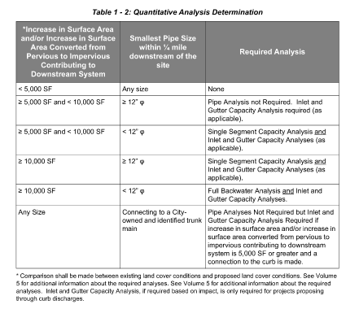
Notes:
Mieke

Slide 166
How to Find Smallest Pipe Size
Remember to save (& reload) the map layers you’ve set up for future projects^{(last} ^{map example!)}
Notes:
Joy

Slide 167
Survey #12 – Is a quantitative downstream analysis required?
Coldest Ice Convenience Store
Downstream Pipes ¼ Mile:
12”
15”
21”
21”
21”
Existing Conditions:
Total Project Area: 32,095 ft²
Total Onsite Lot Area: 28,195 ft²
Gravel Lot: 22,250 ft²
Blackberry Patch: 5945 ft²
Total Offsite Area: 3900 ft²
Hard Packed Dirt/Gravelly Shoulder: 1820 ft²
Existing Road: 2080 ft²
Assessed Value
Land: $509,200
Assessed Improvement: $2,700
Proposed Condition:
Onsite
New Convenience Store
Expected Average Daily Traffic (ADT): 50
New Parking Lot and Drive Aisle: 9,429 ft²
New Building (Roof Area): 8,893 ft²
Walkways: 1,123 ft²
Landscaped Areas: 8,750 ft²
Improvement Value: $750,000
Offsite Improvements:
Sidewalk Frontage: 650 ft²
Half Street Improvements: 2080 ft²
Planter Strip and Back of Walk: 1170 ft²
Example Project!
Notes:
Mieke

Slide 168
Survey #12 – No – Why?
Existing Conditions:
Total Project Area: 32,095 ft²
Total Onsite Lot Area: 28,195 ft²
Gravel Lot: 22,250 ft² ⁻ Impervious
Blackberry Patch: 5945 ft² ⁻ Pervious
Total Offsite Area: 3900 ft²
Hard Packed Dirt/Gravelly Shoulder: 1820 ft² ⁻ Impervious
Existing Road: 2080 ft² ⁻ Impervious
Assessed Value
Land: $509,200
Assessed Improvement: $2,700
Proposed Condition:
Onsite
New Convenience Store
Expected Average Daily Traffic (ADT): 50
New Parking Lot and Drive Aisle: 9,429 ft² - Impervious
New Building (Roof Area): 8,893 ft² - Impervious
Walkways: 1,123 ft² - Impervious
Landscaped Areas: 8,750 ft² - Pervious
Improvement Value: $750,000
Offsite Improvements:
Sidewalk Frontage: 650 ft² - Impervious
Half Street Improvements: 2080 ft² - Impervious
Planter Strip and Back of Walk: 1170 ft² - Pervious
Everything in the existing condition is going to downstream system so we are not looking at increase in surface area but looking to determine if there is an increase in conversion from pervious to impervious.
Existing Condition Impervious = 26,150
Existing Condition Pervious = 5945
Proposed Condition Impervious = 22,175
Proposed Condition Pervious = 9920
For purposes of conveyance system analysis there is a decrease in impervious surface so analysis is not required.
For this example, we assumed there was no infiltration onsite. If there was that would have decreased the contribution to the downstream system even further.
This does not mean discharge can be made directly to curb line.
Example Project!
Notes:
Mieke

Slide 169
Analysis not Required - Can I Discharge Directly to Curb Line?
Only allowed if MR #5 BMPs are not feasible and cannot be used to fully infiltrate or disperse stormwater onsite.
Curb line (asphalt wedge or curb and gutter) must be present.
Conveyance to the curb will only be allowed if:
A catch basin or other inlet to the conveyance system is located within 350 feet downstream of the discharge location.
Stormwater discharges from the project site remains in the gutter line to the nearest stormwater system inlet. Existing or new curb shall be tall enough to ensure water remains in the gutter line.
Stormwater discharges from the project site enter a stormwater system inlet before the next downstream intersection.
Stormwater discharges are not on the high side of full warp street section.
If above conditions cannot be met, extension of the stormwater system is required.
Notes:
Mieke

Slide 170
Submittal Requirements – Infrastructure Protection
Description of reason project must comply or is not required to comply with the Additional Protective Measure.
If required, include the complete Single Segment Capacity Analysis, Inlet and Gutter Capacity Analysis, or Full Backwater Analysis. Include:
All model assumptions including tailwater assumptions.
All model outputs as an attachment/appendix to the SSP Report.
Include a diagram or map showing the pipe segments, inlets, and gutter sections analyzed. Include:
Pipe type
Slope
Inlet type
Downstream survey if required by Environmental Services/Site Development Group.
Provide existing and proposed basin maps that clearly show land use conditions and acreages (or square feet) used in the analysis.
Provide analysis results including:
Hydraulic gradeline
Locations where stormwater overtops the conveyance system.
If the existing and proposed basin maps have sufficient information, it is not necessary to include the map twice but it is necessary to appropriately reference the figure number in the calculations/narrative.
Description of proposed mitigation measures including all design calculations and modeling outputs.
Notes:
Mieke

Slide 171
Conveyance System Design
All new conveyance systems shall be designed using the Full Backwater Analysis. The design events for pipe systems are as follows.
For privately maintained systems:
For the 10-year, 24-hour design storm, assuming a Type 1A rainfall distribution (3.0-inches) using a 10-minute timestep, there shall be a minimum of 0.5 feet of freeboard between the water surface and the top of any maintenance hole or catch basin.
For the 100-year, 24-hour design storm, assuming a Type 1A rainfall distribution (4.1-inches) using a 10-minute timestep, overtopping of the pipe conveyance system may occur, however, the additional flow shall not extend beyond half the lane width of the outside lane of the traveled way and shall not exceed 4 inches in depth at its deepest point.
For the 100-year, 24-hour design storm assuming a Type 1A rainfall distribution (4.1-inches) using a 10-minute timestep, off-channel storage on private property is allowed with recording of the proper easements. When this occurs, the additional flow over the ground surface is analyzed using the methods for open channels described in Section 3.4.4 Open Channel Design Events. Per Joint Administrative Policy and Procedure Directive No. 2021-02-001, Environmental Services/Site Development Group will evaluate and determine the acceptability of this type of localized flooding.
For publicly maintained systems:
For the 25-year, 24-hour design storm, assuming a Type 1A rainfall distribution (3.5-inches) using a 10-minute timestep, there shall be a minimum of 0.5 feet of freeboard
between the water surface and the top of any maintenance hole or catch basin.
For the 100-year, 24-hour design storm, assuming a Type 1A rainfall distribution (4.1-inches)using a 10-minute timestep, overtopping of the pipe conveyance system may occur, however, the additional flow shall not extend beyond half the lane width of the outside lane of the traveled way and shall not exceed 4 inches in depth at its deepest point.
The starting tailwater elevation to be used in the backwater analysis for pipe systems is the water surface elevation of the next downstream pipe at an assumed depth of 90% full.
For discharges to tidally influenced areas, the tailwater elevation shall not be lower than 4.64 feet (which is a conservative estimate of the mean high tide) using current City of Tacoma datum.
For the 100-year, 24-hour design storm assuming a Type 1A rainfall distribution (4.1-inches), if overtopping of the system occurs, the applicant shall show the extent of the impacts on neighboring properties and the right-of-way. The full extent of flooding shall be shown. The applicant may be required to provide mitigation for localized flooding. Environmental Services/ Site Development Group reserves the right to make the determination of final mitigation requirements.
Notes:
Mieke

Slide 172
Conveyance System Design
Include all information necessary to show how the conveyance system was designed. Include the following as applicable:
A narrative that discusses all results and clearly describes compliance with design criteria.
All model assumptions including tailwater assumptions.
A diagram or map showing the pipe segments, inlets, and gutter sections analyzed. Include:
Pipe type
Slope
Inlet type
Downstream survey if required by Environmental Services/Site Development Group.
Existing and proposed basin maps that clearly show land use conditions and acreages (or square feet) used in the analysis.
Show subbasin for each inlet to the system.
Provide contours/elevations used to determine flow paths at a basin level.
Provide analysis results including:
Hydraulic gradeline
Inlet and Rim Elevations relevant to hydraulic gradeline for all necessary design events.
All model outputs as an attachment/appendix to the SSP Report.
Notes:
Mieke

Slide 173
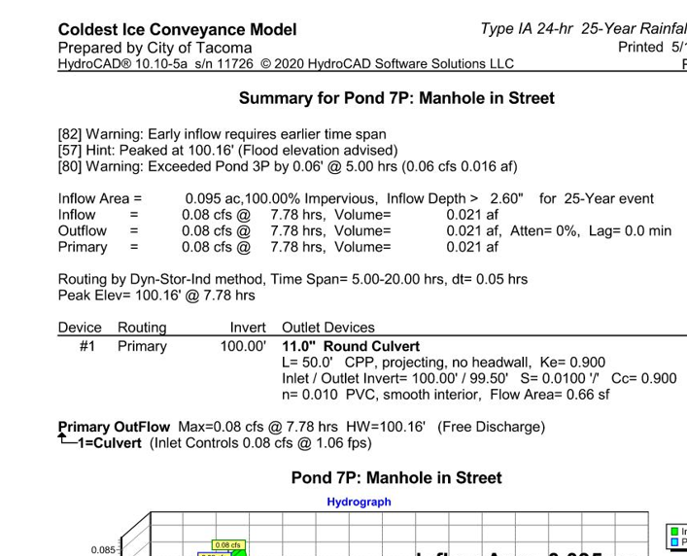
Our Project – Conveyance System Design
Example Project!
Notes:
Mieke

Slide 174
Infrastructure Protection and Conveyance Design – Common Misses
No conveyance system design.
Continuous simulation model used for conveyance design.
Full backwater analysis not used for design.
Backwater not assumed.
Pipes types and slopes in calculations do not match plan set.
Notes:
Mieke

Slide 175
Exceptions, Adjustments, Modifications
Exception – A request to not apply a Minimum Requirement to a project. Exceptions must meet the following:
Application of the Minimum Requirement(s) would impose a severe and unexpected economic hardship; and
The exception will not increase risk to the public health and welfare, nor be injurious to other properties in the vicinity and/or downstream, and to the quality of waters of the state; and
The exception is the least possible exception that could be granted to comply with the intent of the Minimum Requirements.
Exception request would be included as a separate appendix in the SSP and in the MR section of the SSP it would reference that exception is being used.
Decision to grant is sole discretion of ES/SDG
Notes:
Mieke

Slide 176
Exceptions, Adjustments, Modifications
Adjustment – Reduction or modification of a MR or permitting an alternative requirement.
Applications for an adjustment to a Minimum Requirement shall include documentation that outlines how:
The adjustment provides substantially equivalent environmental protection; and
Based on Sound Engineering Practices, the objectives of safety, function, environmental protection and facility maintenance are met.
Adjustment requests would be included as a separate appendix in the SSP and in the MR section of the SSP it would reference that adjustment is being made.
Decision to grant is sole discretion of ES/SDG
Notes:
Mieke

Slide 177
Exceptions, Adjustments, Modifications
Modification – change to design standard in the SWMM.
Clearly note these in the SSP in section where design standard is different.
Describe why the standards in the SWMM cannot be met and why the modification will not likely affect downstream properties, stormwater system function and operation, the quality of waters of the state, the facility function, and the health and welfare of the public.
Decision to grant is sole discretion of ES/SDG
Notes:
Mieke

Slide 178
Appendices
Soils Report – State Name of Separate Stand-Alone Document
Common mistake: soils report do not match BMP design and do not include appropriate information for MR # infeasibility.
Common mistake: soils logs are not taken at appropriate depths.
Wetland Delineation Report – State Name of Separate Stand-Alone Document
Design Calculations and Modeling Reports
Include complete modeling reports.
Clearly highlight in modeling reports values that were used in calculations.
Include BMP design calculations – not just modeling reports.
Include all assumptions and outcomes.
Common mistake – Modeling Report not included. Calculations not included. Modeling report included but facility size calculations not included.
Common mistake – calculation inputs do not match plan set (orifice sizes wrong, elevations wrong).
Emerging Technology Use Level Designations
Include most current from ECY website
Relevant Historical Reports
Notes:
Mieke

Slide 179
Other Commonly Missed Items - General
Not packaging material appropriately. 10-20 different documents that should have all been included in SSP.
Basins maps do not clearly show different cover conditions – hatching or color are too similar to discern differences between types.
Plan sets do not match report.
Facility sizing does not match facility shown.
Basin maps don’t match reality.
Plan sets not accurate or do not include complete information
Not to Scale
Pipe slopes
Inverts
Rim Elevations
Facility Dimensions
Utility Conflicts
Total Amount of PGIS required not flowing into facility.
No details or details do not match other plan sets.
Notes:
Mieke

Slide 180
Questions? Please Use Q&A…and final words of wisdom!
Knowledge is knowing a tomato is a fruit.
Wisdom is not putting it in a fruit salad.
Notes:
Mieke

Slide 181
Post Zoom Survey
You should receive a survey after this webinar ends. Please fill out to let us know how we are doing and if you have any ideas for future trainings, etc.

Slide 182
Wrap Up
Thanks for attending this training
We hope it is helpful to you now and in future
Slide deck and recording will be available at www.cityoftacoma.org/stormwatermanual
Hopefully by end of the month.
Contact us if you have specific questions:
Mieke Hoppin – mhoppin@cityoftacoma.org
Joy Rodriguez – jrodrigu@cityoftacoma.org
Brenda Reifsnyder – breifsnyder@cityoftacoma.org
Chris Johnson – cjohnso2@cityoftacoma.org
Notes:
Mieke

